Slide 1

TAKE A LOOK AT OUR ACCOMLISHMENTS FROM THE 2014 FIRST ROBOTICS COMPETITION YEAR
Notes:
1

Slide 2
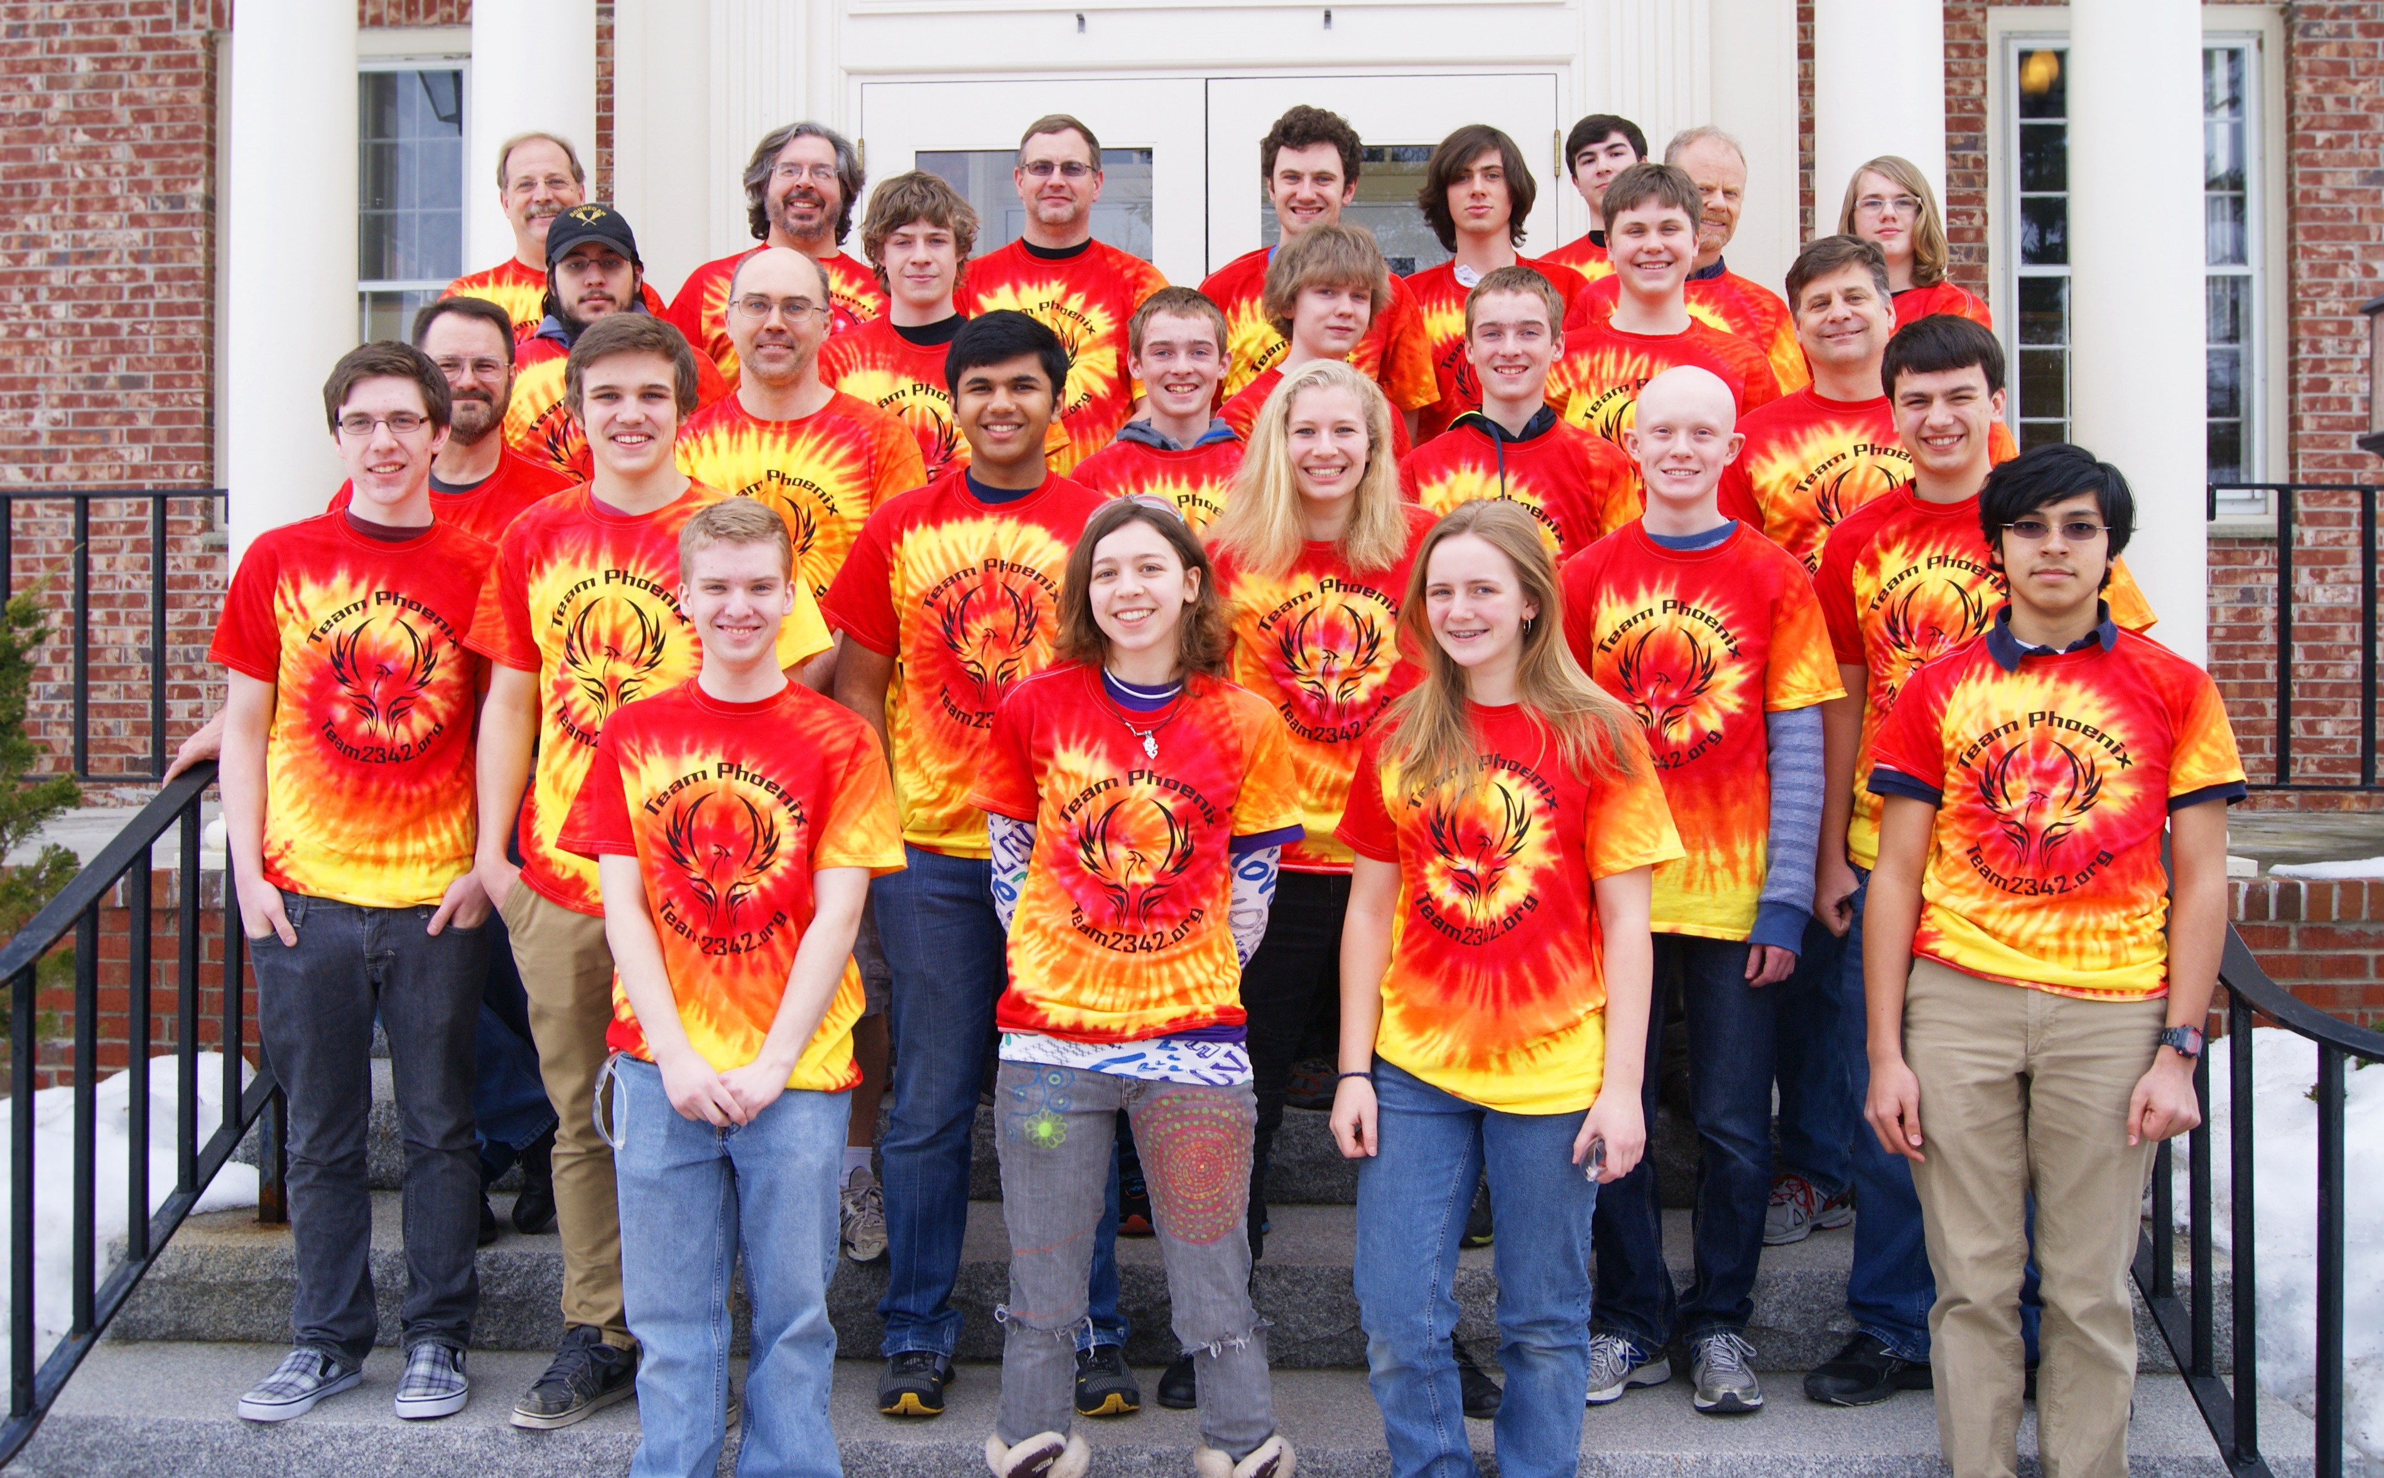
Our Team

Slide 3
What We Do
During the six week build season our team works together to design, build, wire, and program a robot. However, building robots is not the only thing Team 2342 does. We are very involved with the community and run a variety of events. Every year we sponsor a First Lego League (FLL) Tournament. We train referees, set up for the competition, and then spend a day running the entire event. Team members also design the trophies used at these FLL Tournaments. Another major outreach activity we do is traveling to various schools to give presentations about FIRST and STEM. Students love seeing our robots and are able to ask us questions about engineering – some of the students we have talked to definitely want to pursue a STEM career.

Slide 4
Who We Are
Team 2342 is a group of high school students from the greater Nashua, New Hampshire area that meet out of Daniel Webster College. Unlike most other FRC teams, we do not have a single school affiliation – the majority of our students come from home school groups, private schools, and the Academy for Science and Design. Our team is student run and operated. Our mentors provide insight and guidance, but the majority of the work is done by students. The team works together to design the robot. The mentors help the students throughout the design process and construction. Students leave the team knowing how to use CAD software, operate shop machines, program, wire, and work in a team environment. We are known in the FRC world as a team with unique robots and have been awarded Creativity and Industrial Design Awards at Regional Competitions.
Notes:
4

Slide 5
Team Mission
The mission of the team is to provide an accessible, innovative program to build not only science and technology skills and interests, but also self-confidence, leadership, business, and life skills. Based on the FIRST program, the team strives to enhance the learning of science and engineering, respect the values and abilities of various members, inspire innovation, responsibility and teamwork, as well as creating partnerships. When successful, we will be recognized as a FIRST team to emulate.
Notes:
5

Slide 6
Our Students
 | Mechanical | Software | Wiring | Business | Systems
Seniors | Jacques Joseph |  |  | Devon
In the Middle | Devony | Henri | Sabra Ryan G. | Georges | Ryan G. Georges
First Year | Eric Matt Nic M. Aditya Bryce John Nathaniel Nick Z. | Ryan N. Tyler | Jeremy Michael | Liam Aditya | Spencer
Notes:
6

Slide 7
Our Mentors
 | Mechanical | Software | Wiring | Business | Systems
Long Time Mentors | Stephen Hebert Robert Melanson Alec Muller | Bruce George Kent Glossop | Kent Glossop Jean-Marc Mourant | Melissa Best Bruce George Kate Muller | Kent Glossop Jean-Marc Mourant
First Year Mentors | Stephen Christensen | George Gong Peter Gousios Gary North
DWC Mentors | Nicholas DeMarco Ryan Simpson

Slide 8
Pre-Build Season
Training
Shop Safety
Mini-Build Season
Events/Outreach
Touring
Fundraising
Recruiting
FIRST Lego League (FLL) Tournament

Slide 9
Training
Shop Safety
Mini-Build Season
4 week limit
Game Designed by Systems Subteam

Slide 10
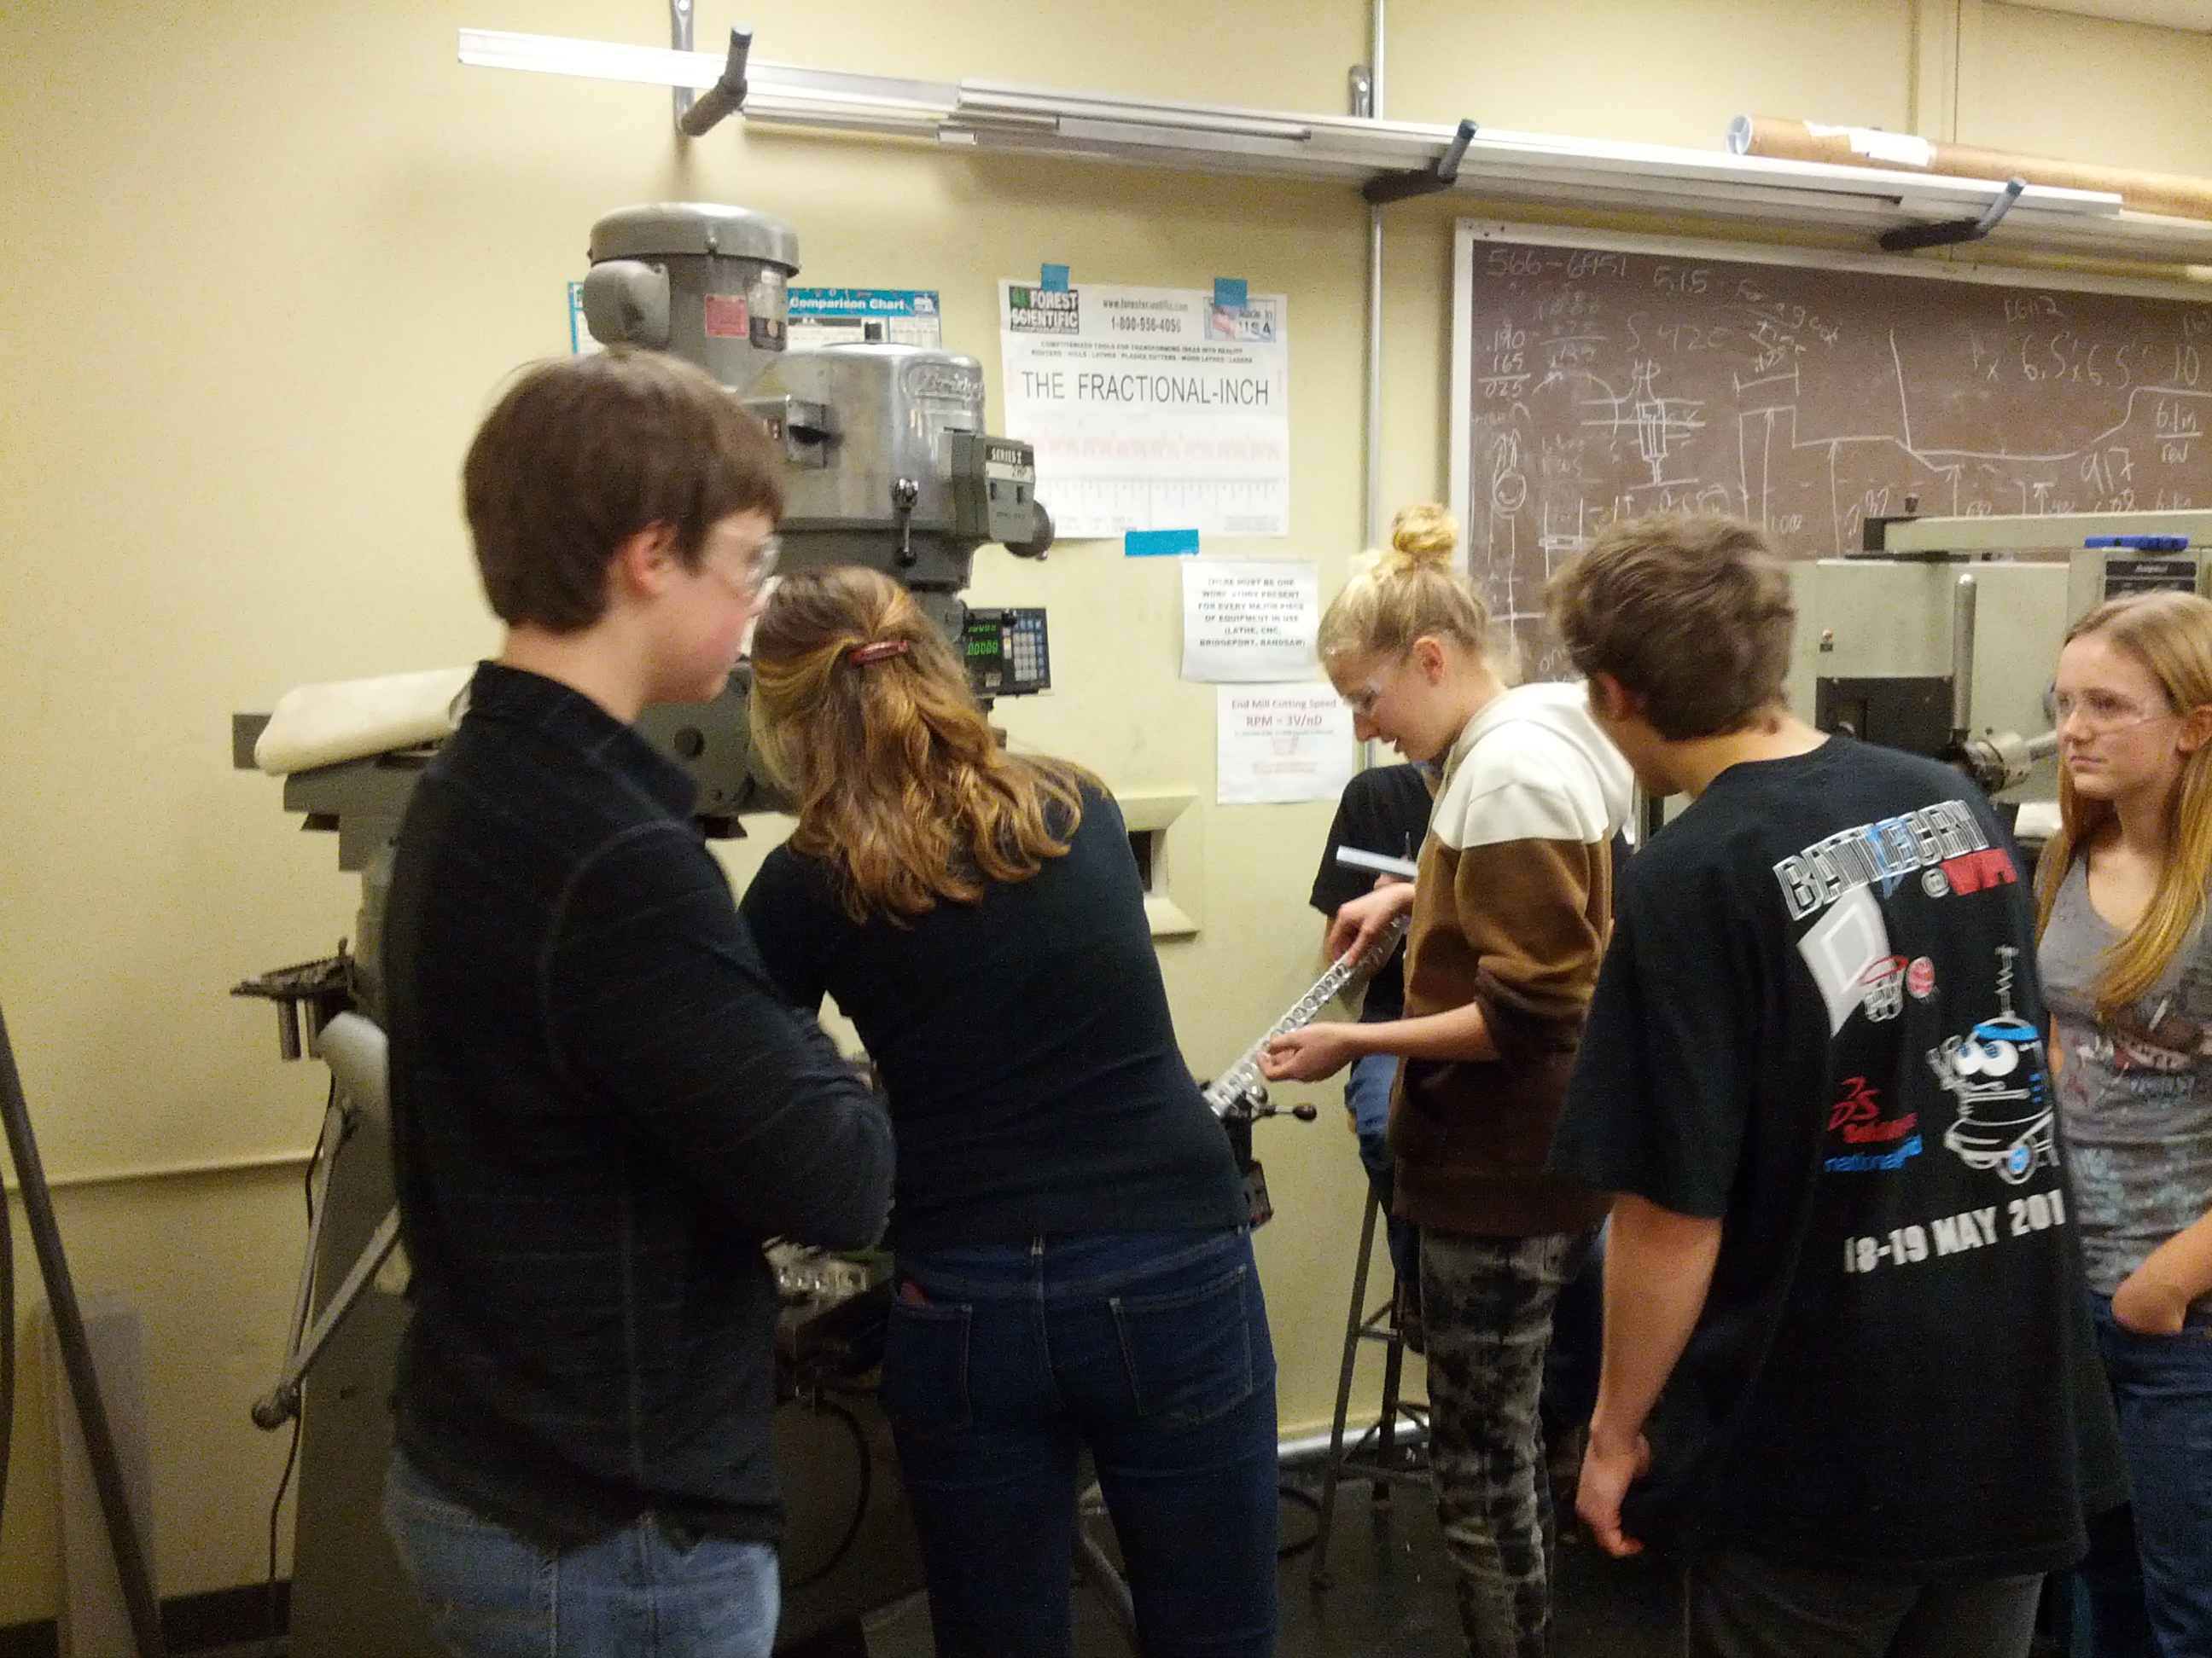
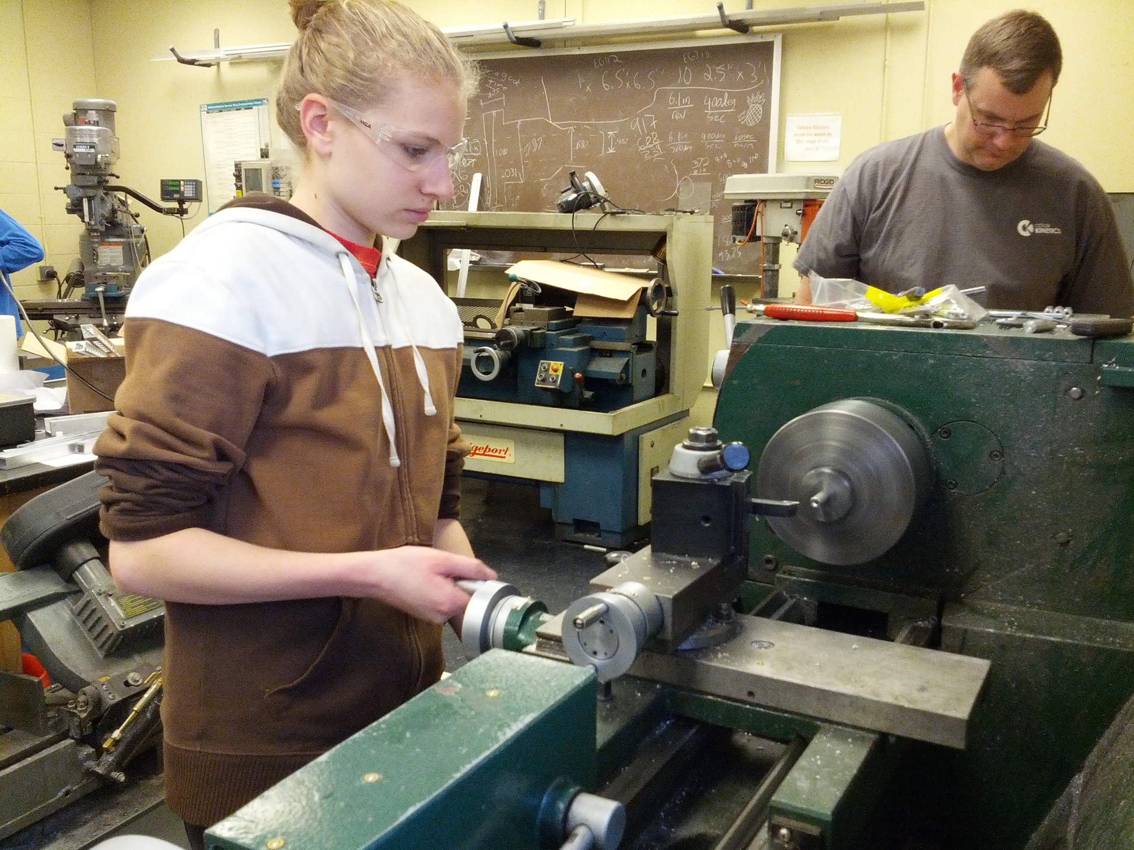
Shop Safety
Team members and Mentors attended a shop safety class. After learning about basic shop safety, the team learned how to use the tools and equipment.

Slide 11
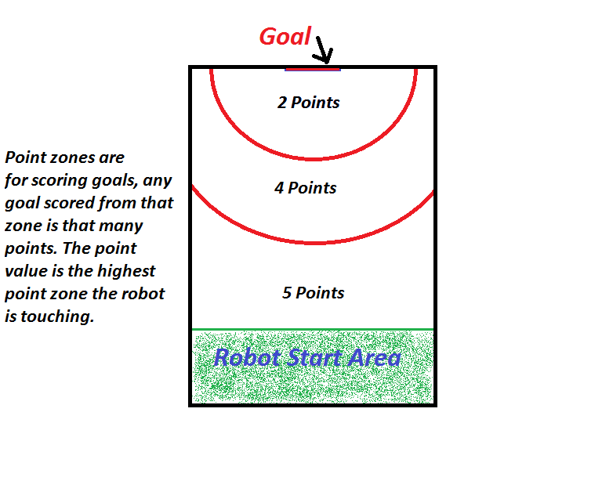
Game – Mini-Build Season

Slide 12
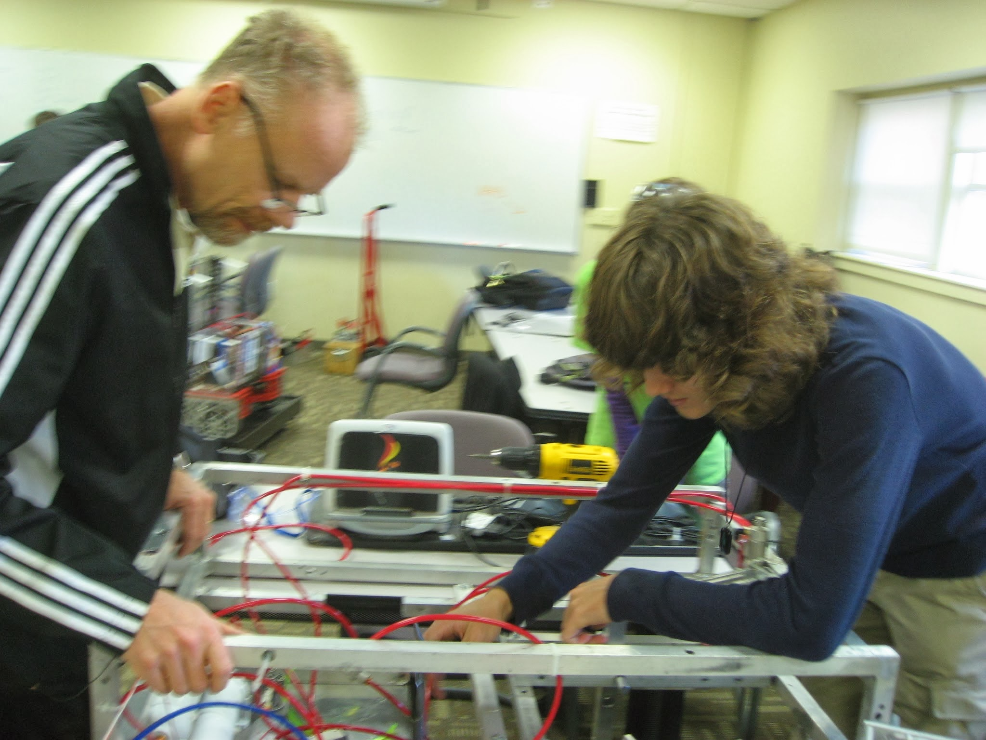
Photos – Mini-Build Season

Slide 13
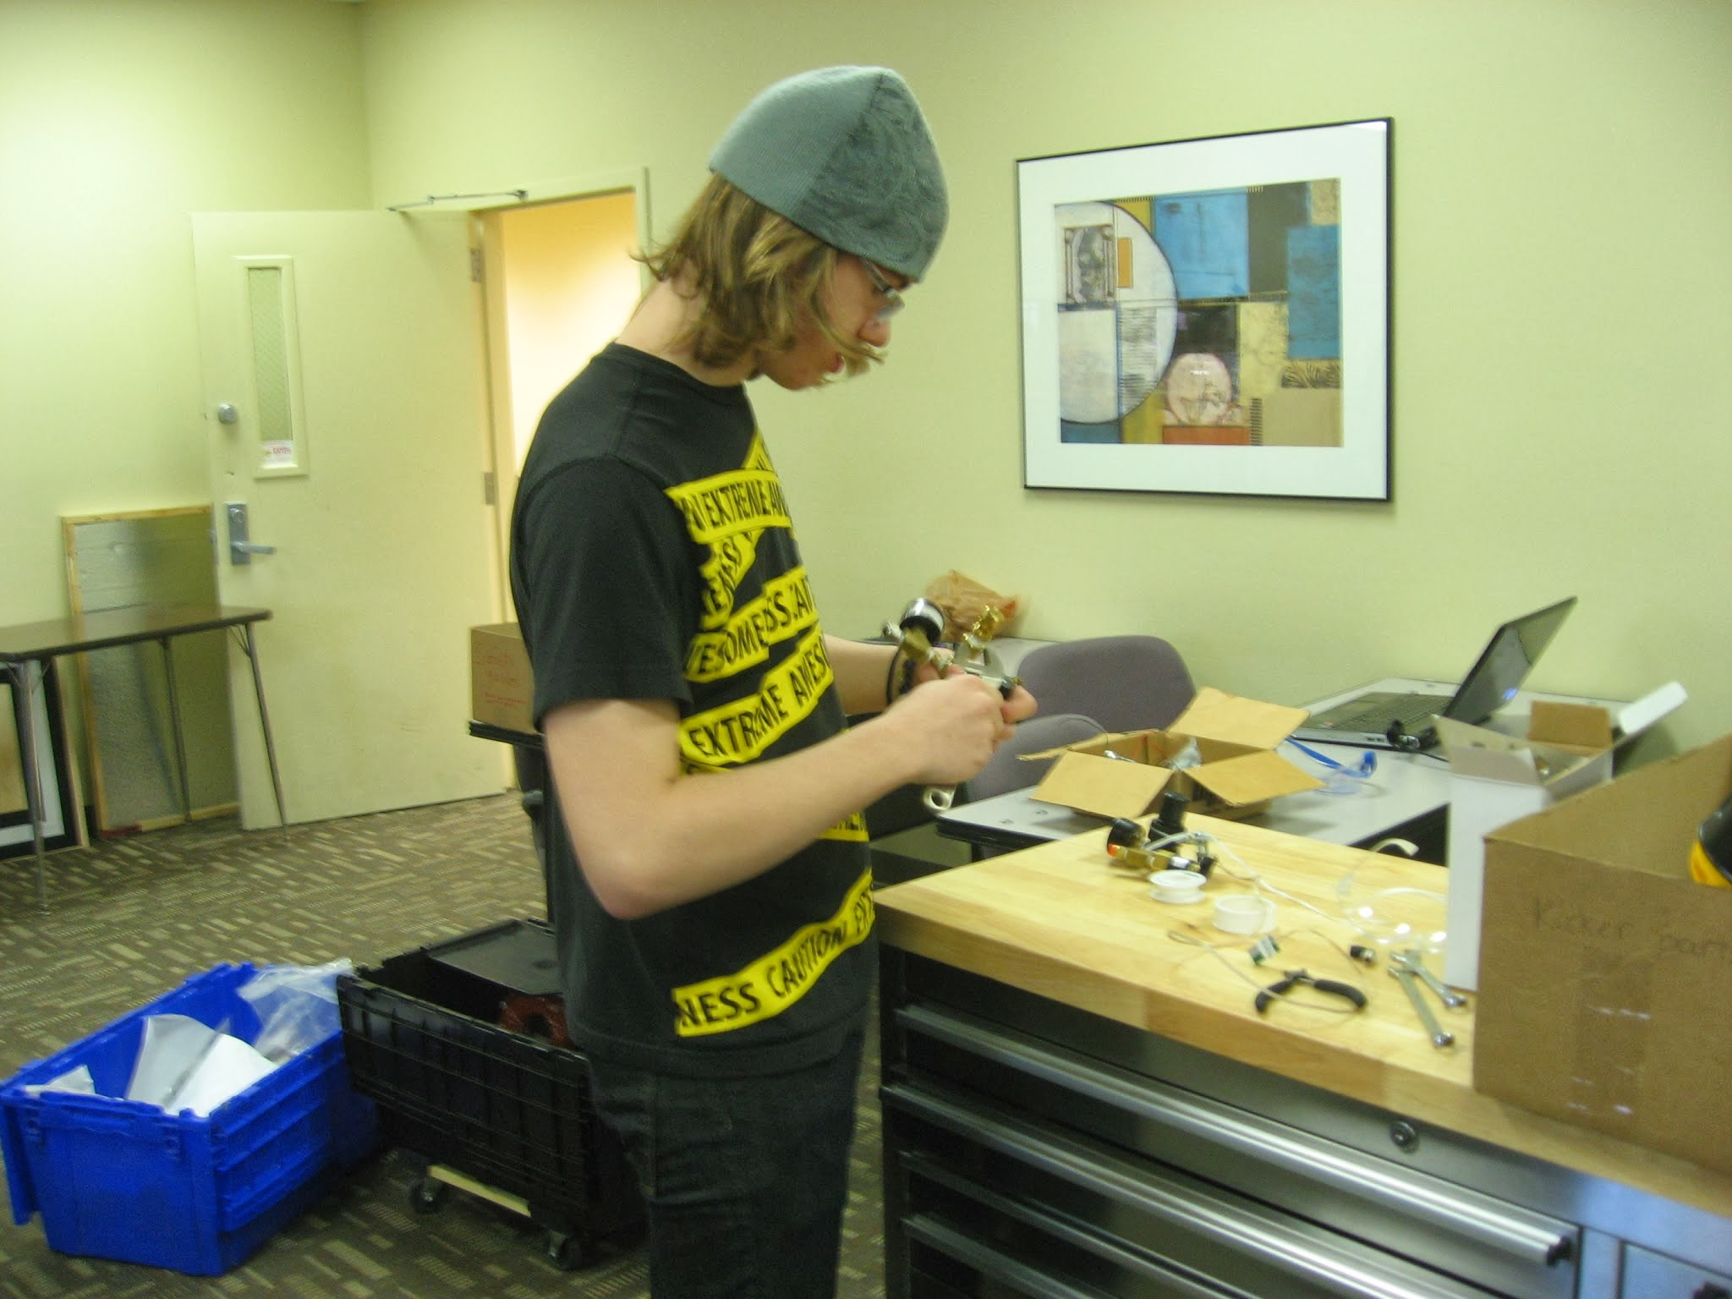
Photos – Mini-Build Season

Slide 14
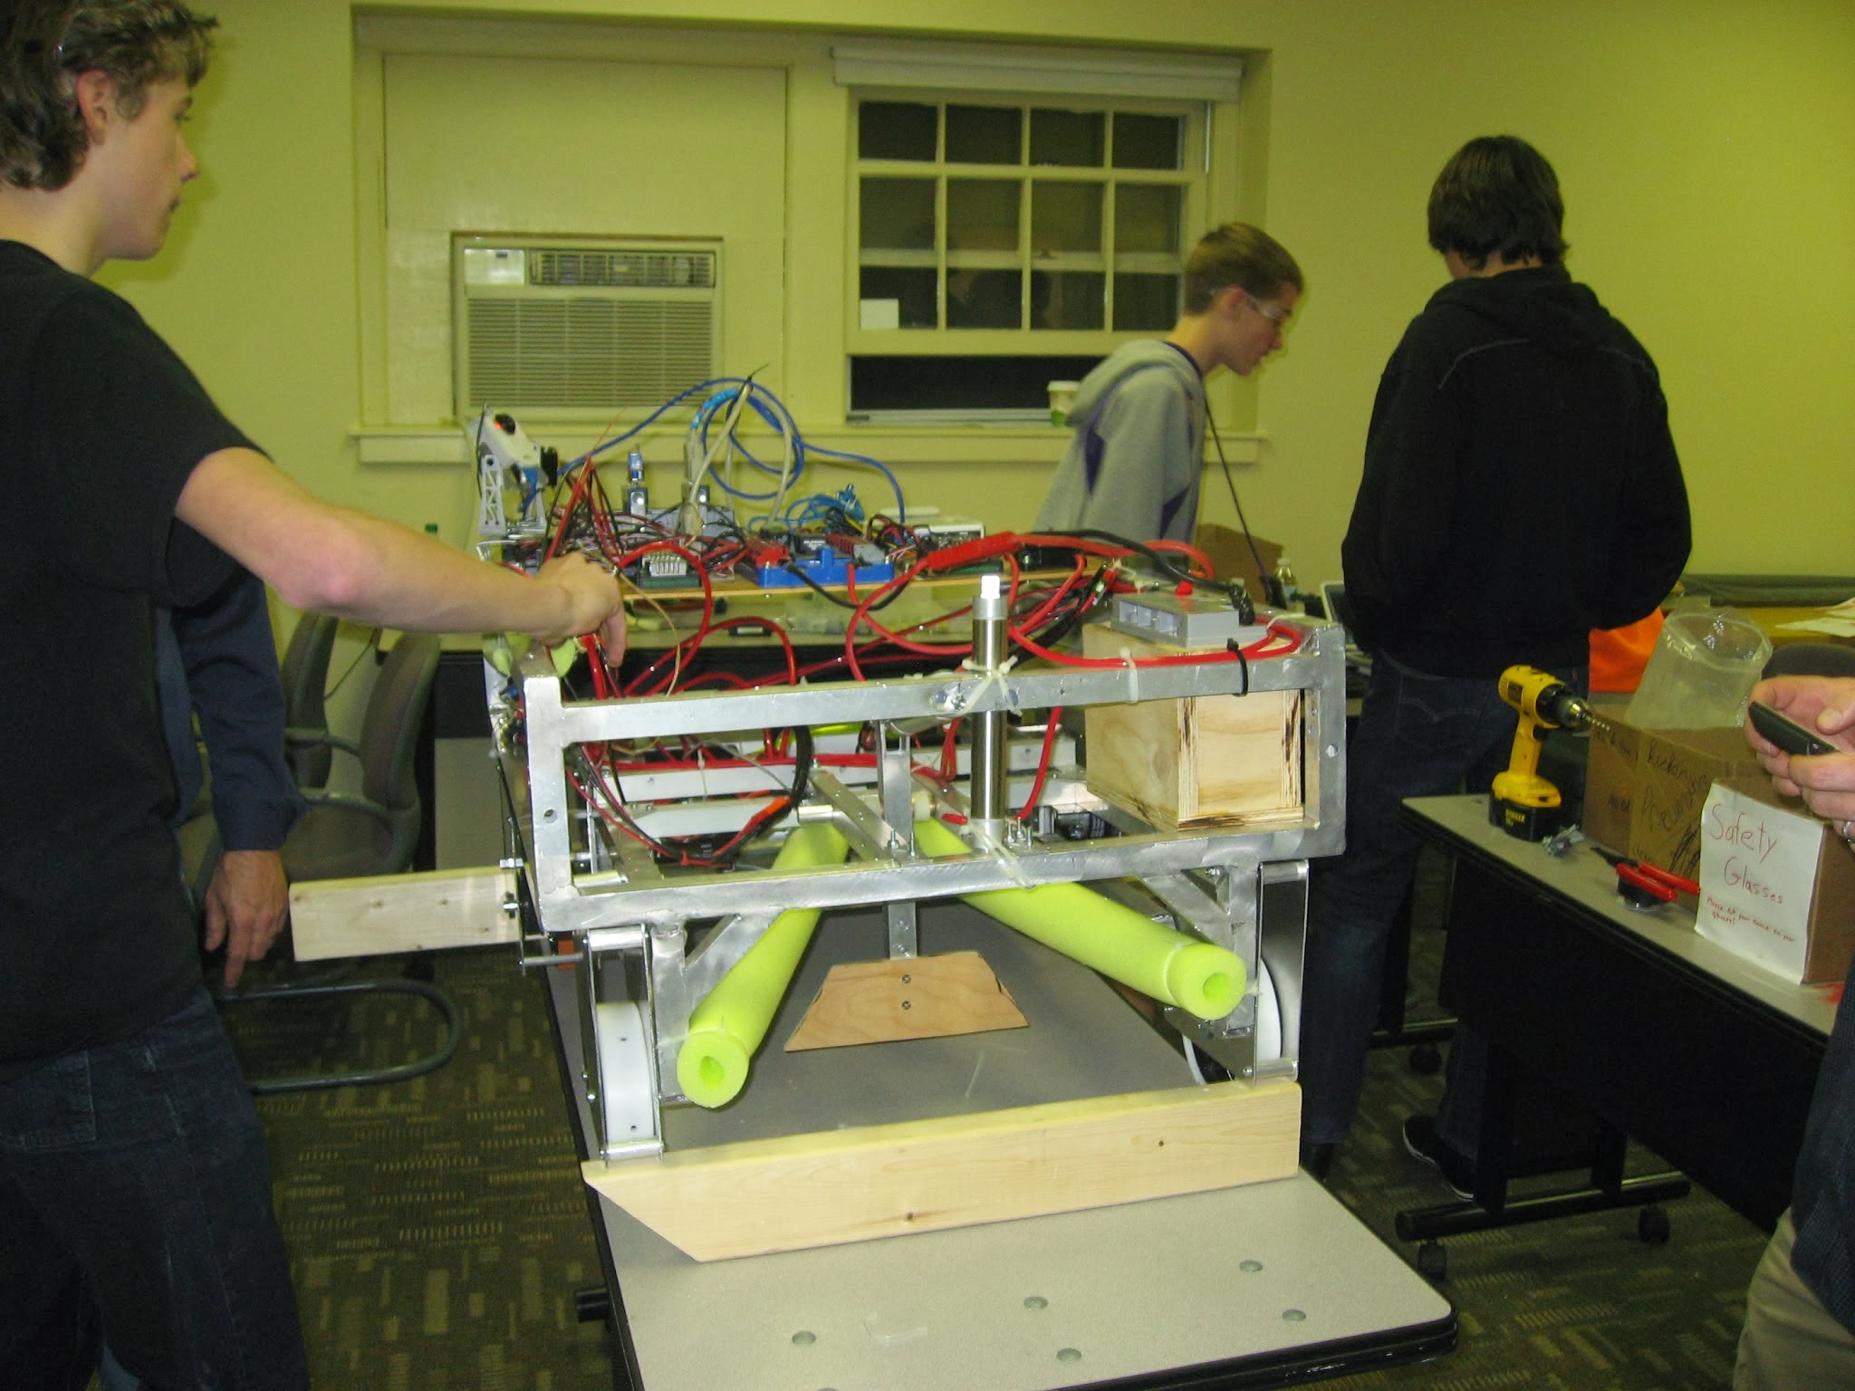
Photos – Mini-Build Season

Slide 15
Events/Outreach
Touring
iRobot
Fundraising
Gift Wrapping @ Barnes & Noble
Recruiting
Presentation @ Barnes & Noble with Liberty Harbor Academy
3 Open Houses @ Daniel Webster College
Presentation @ Academy for Science and Design
FIRST Lego League (FLL) Tournament
Notes:
15

Slide 16

iRobot – Touring
iRobot gave us a tour of their work facilities. During this tour we learned about their robot history and some of their products. The tour gave the team a better understanding of how technology is being used in innovative and creative ways.

Slide 17
Presentation @ Barnes & Noble with LHA – Recruiting
Team 2342 had a fundraising activity and robot demonstration at Barnes and Noble in Manchester, NH. New team members had the opportunity to speak about our team and demonstrate the robot for the first time. This was a great opportunity to present about FIRST Lego League and FIRST Robotics and to recruit new team members and mentors.

Slide 18
Open Houses – Recruiting
The team hosted three open houses in the fall of 2013. They were very successful and we recruited many students. The size of our team tripled due to these open houses. We won the Judges Award at Pine Tree District Event because of our growth (more this later).

Slide 19
FIRST Lego League (FLL) Tournament
Every year Team 2342 hosts a FIRST Lego League (FLL) Tournament. We supply referees, judges and other volunteer staff. The event takes place at Daniel Webster College who generously provides the building. BAE Systems also sponsors this event.

Slide 20
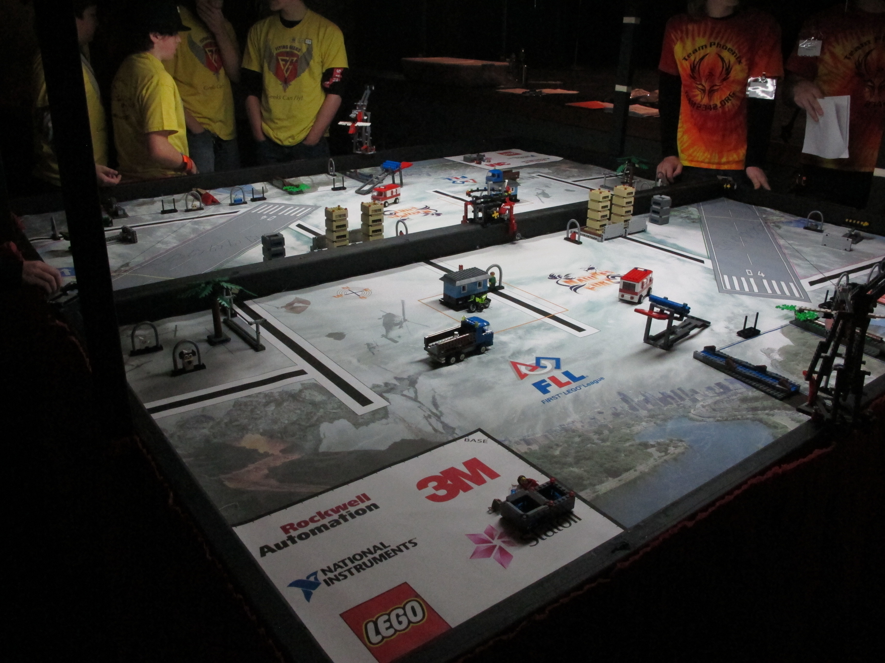
FIRST Lego League (FLL) Tournament
The playing field

Slide 21
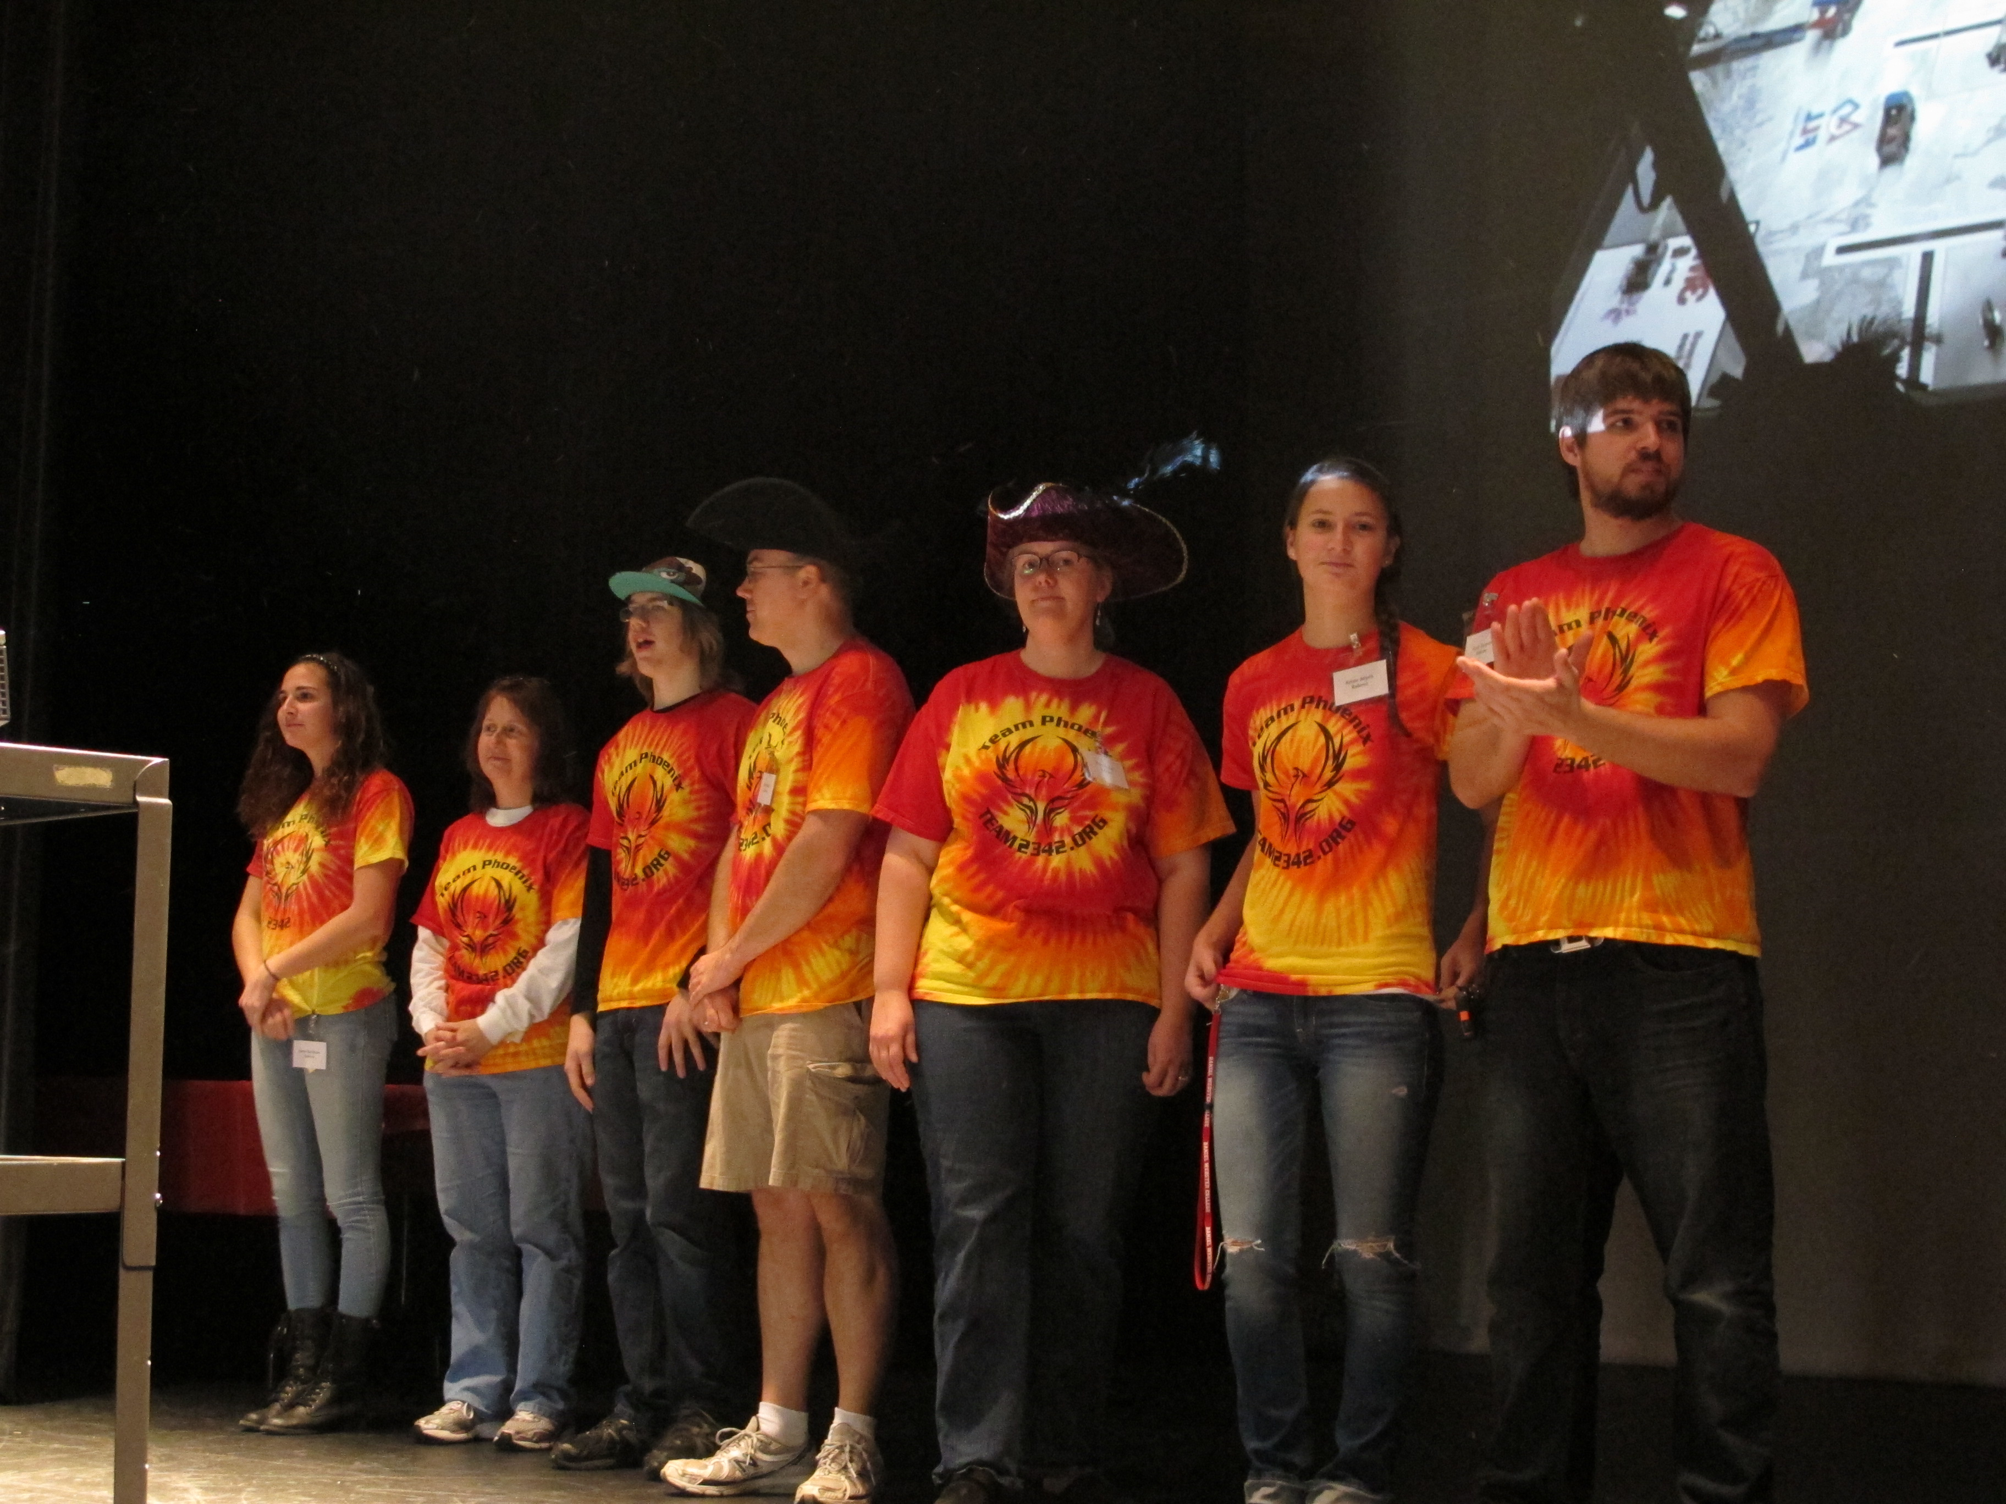
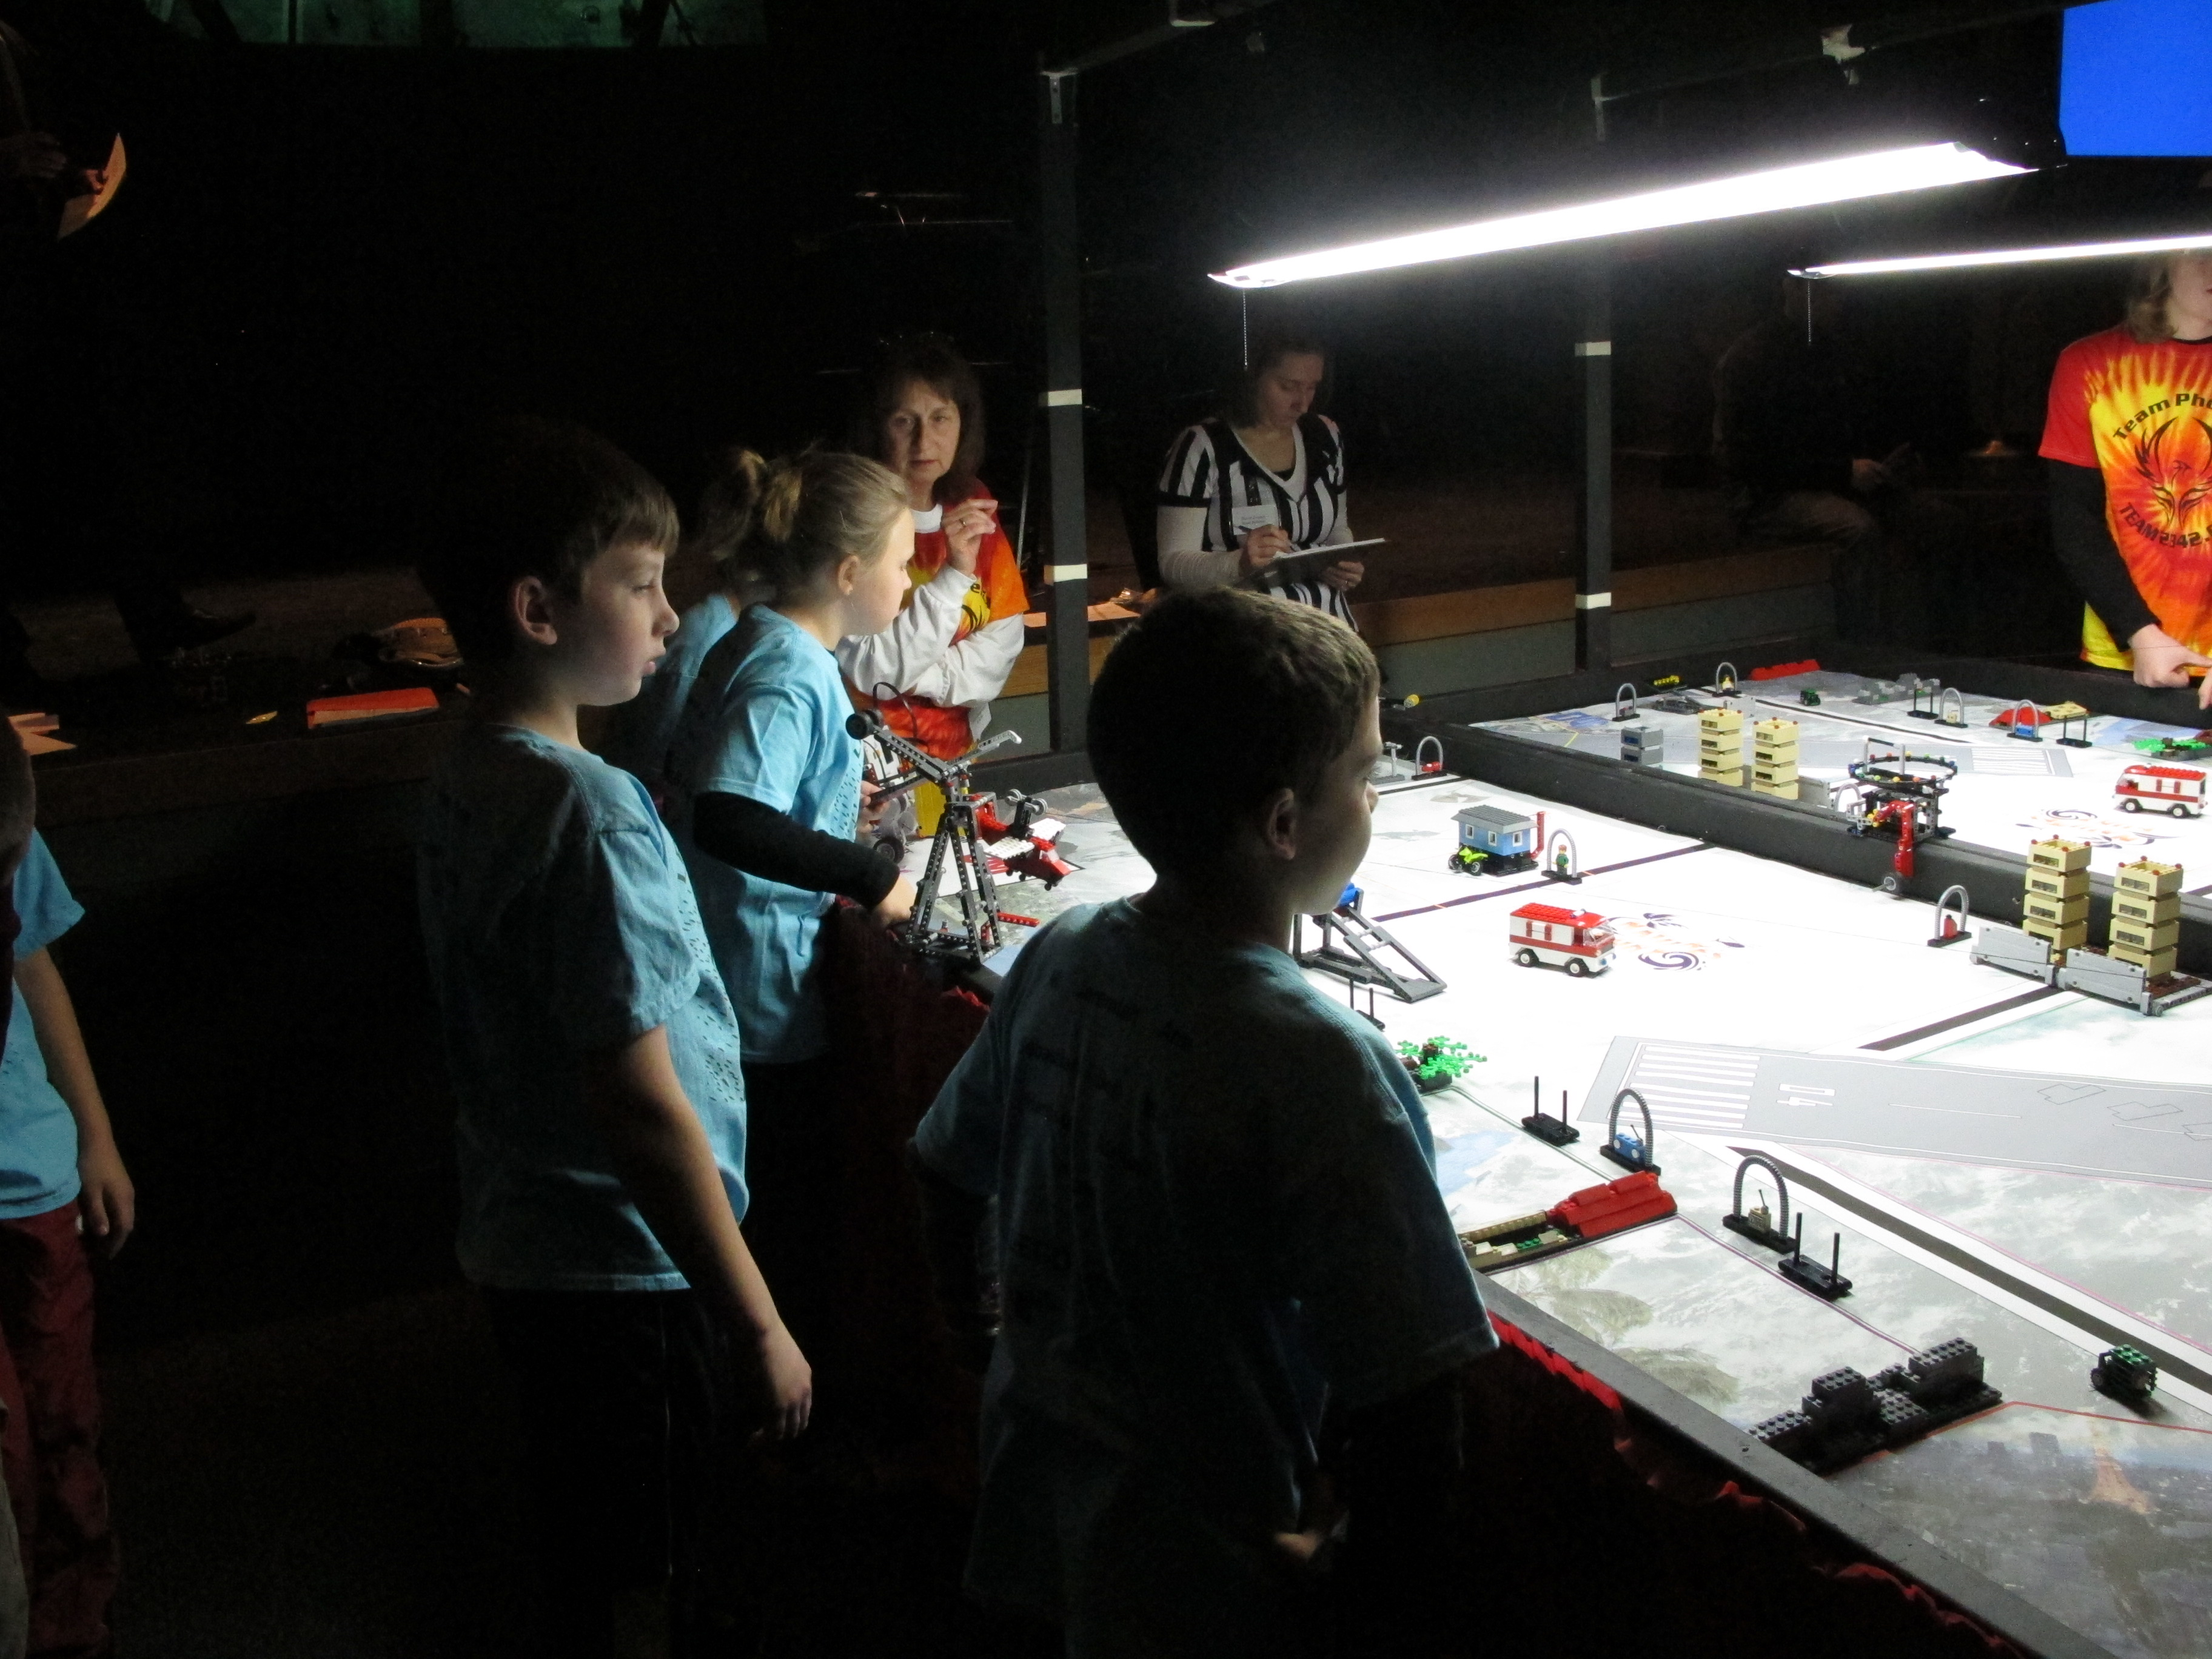
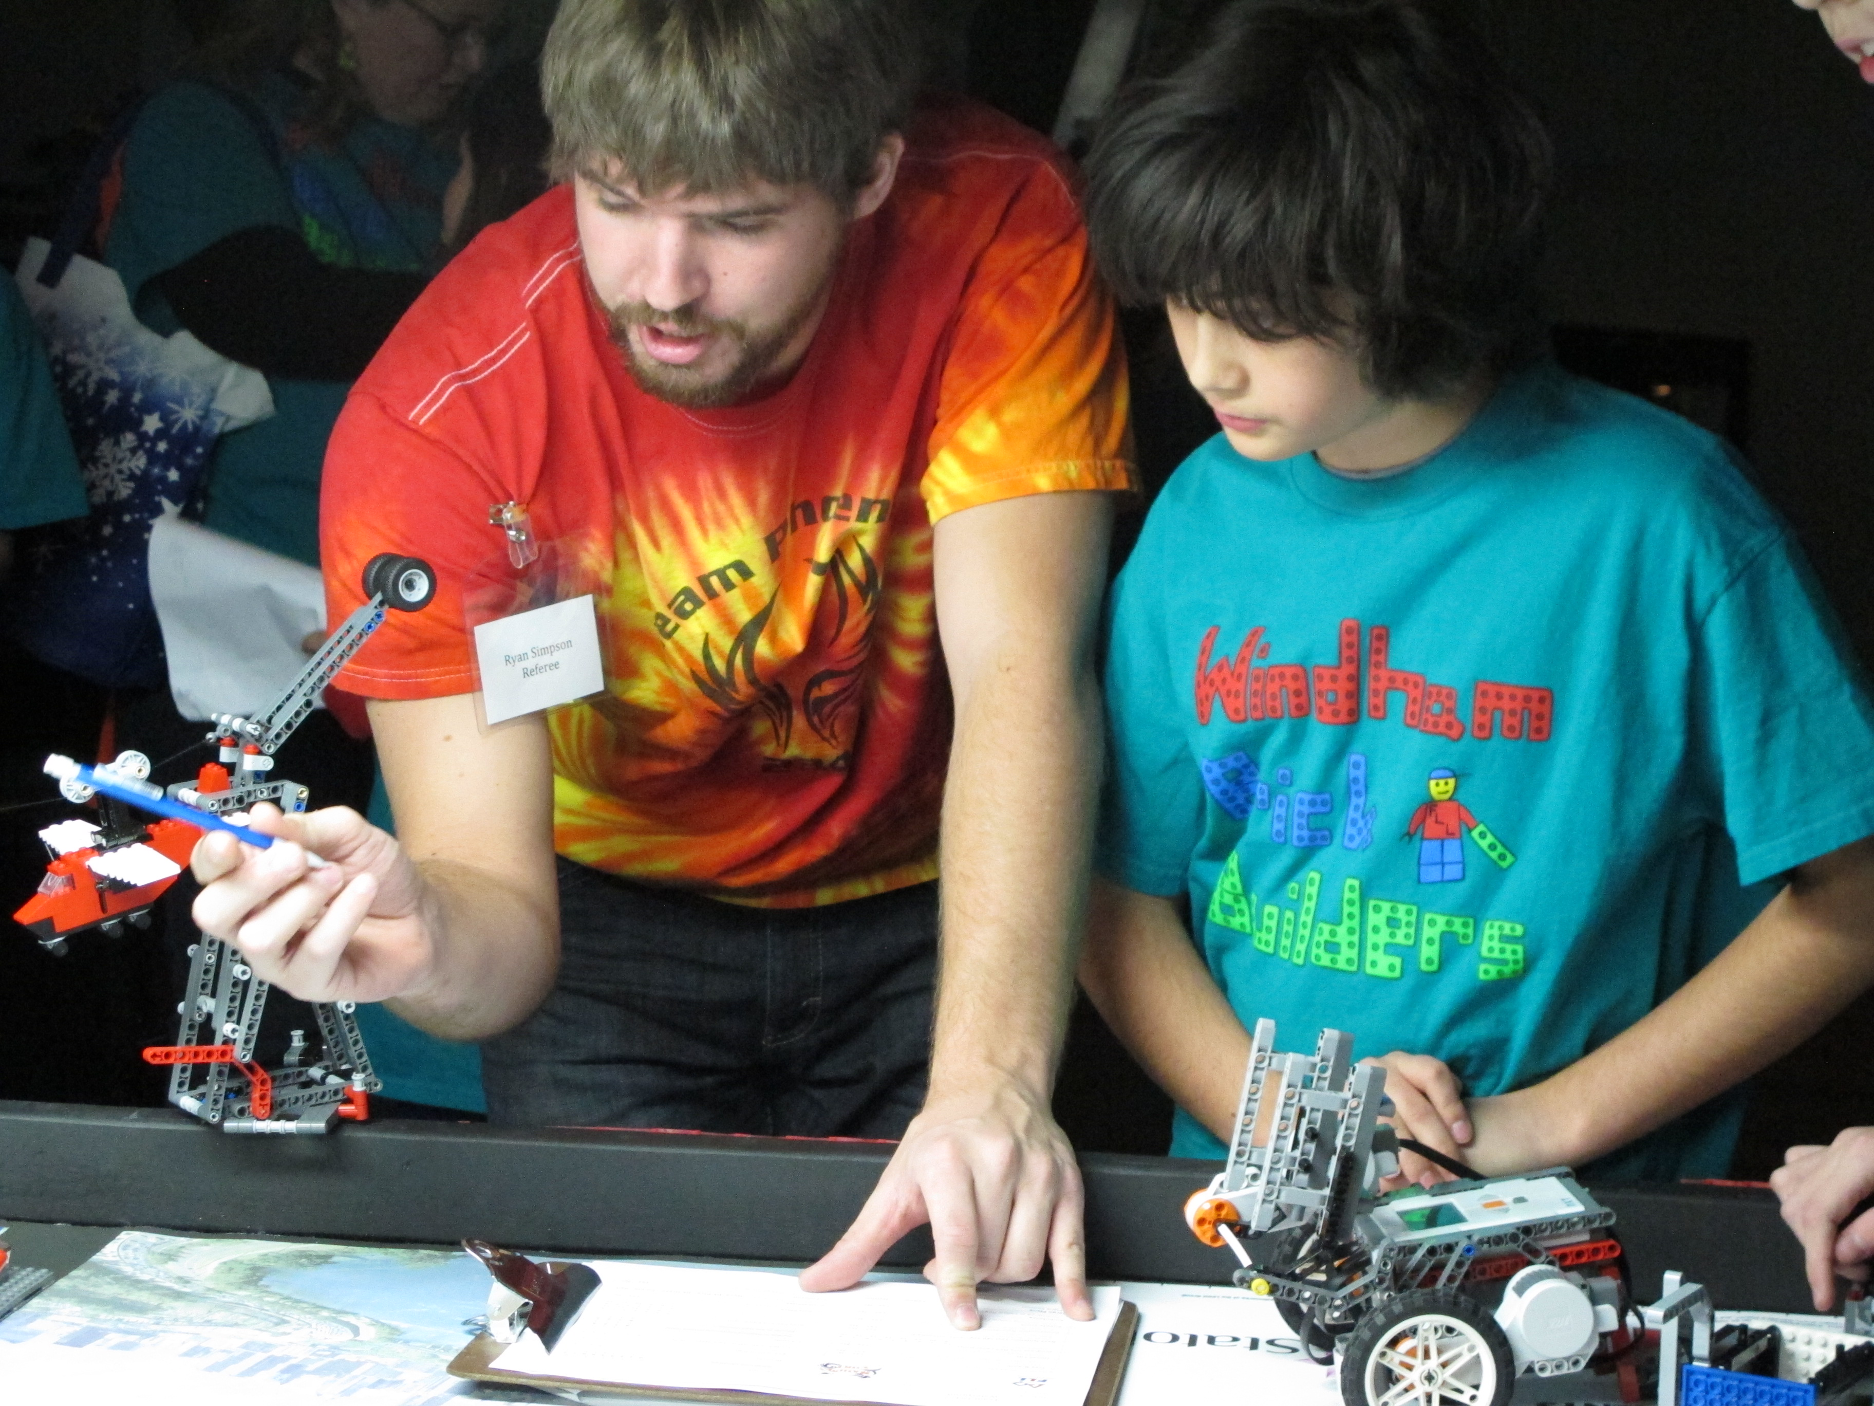
FIRST Lego League (FLL) Tournament

Slide 22
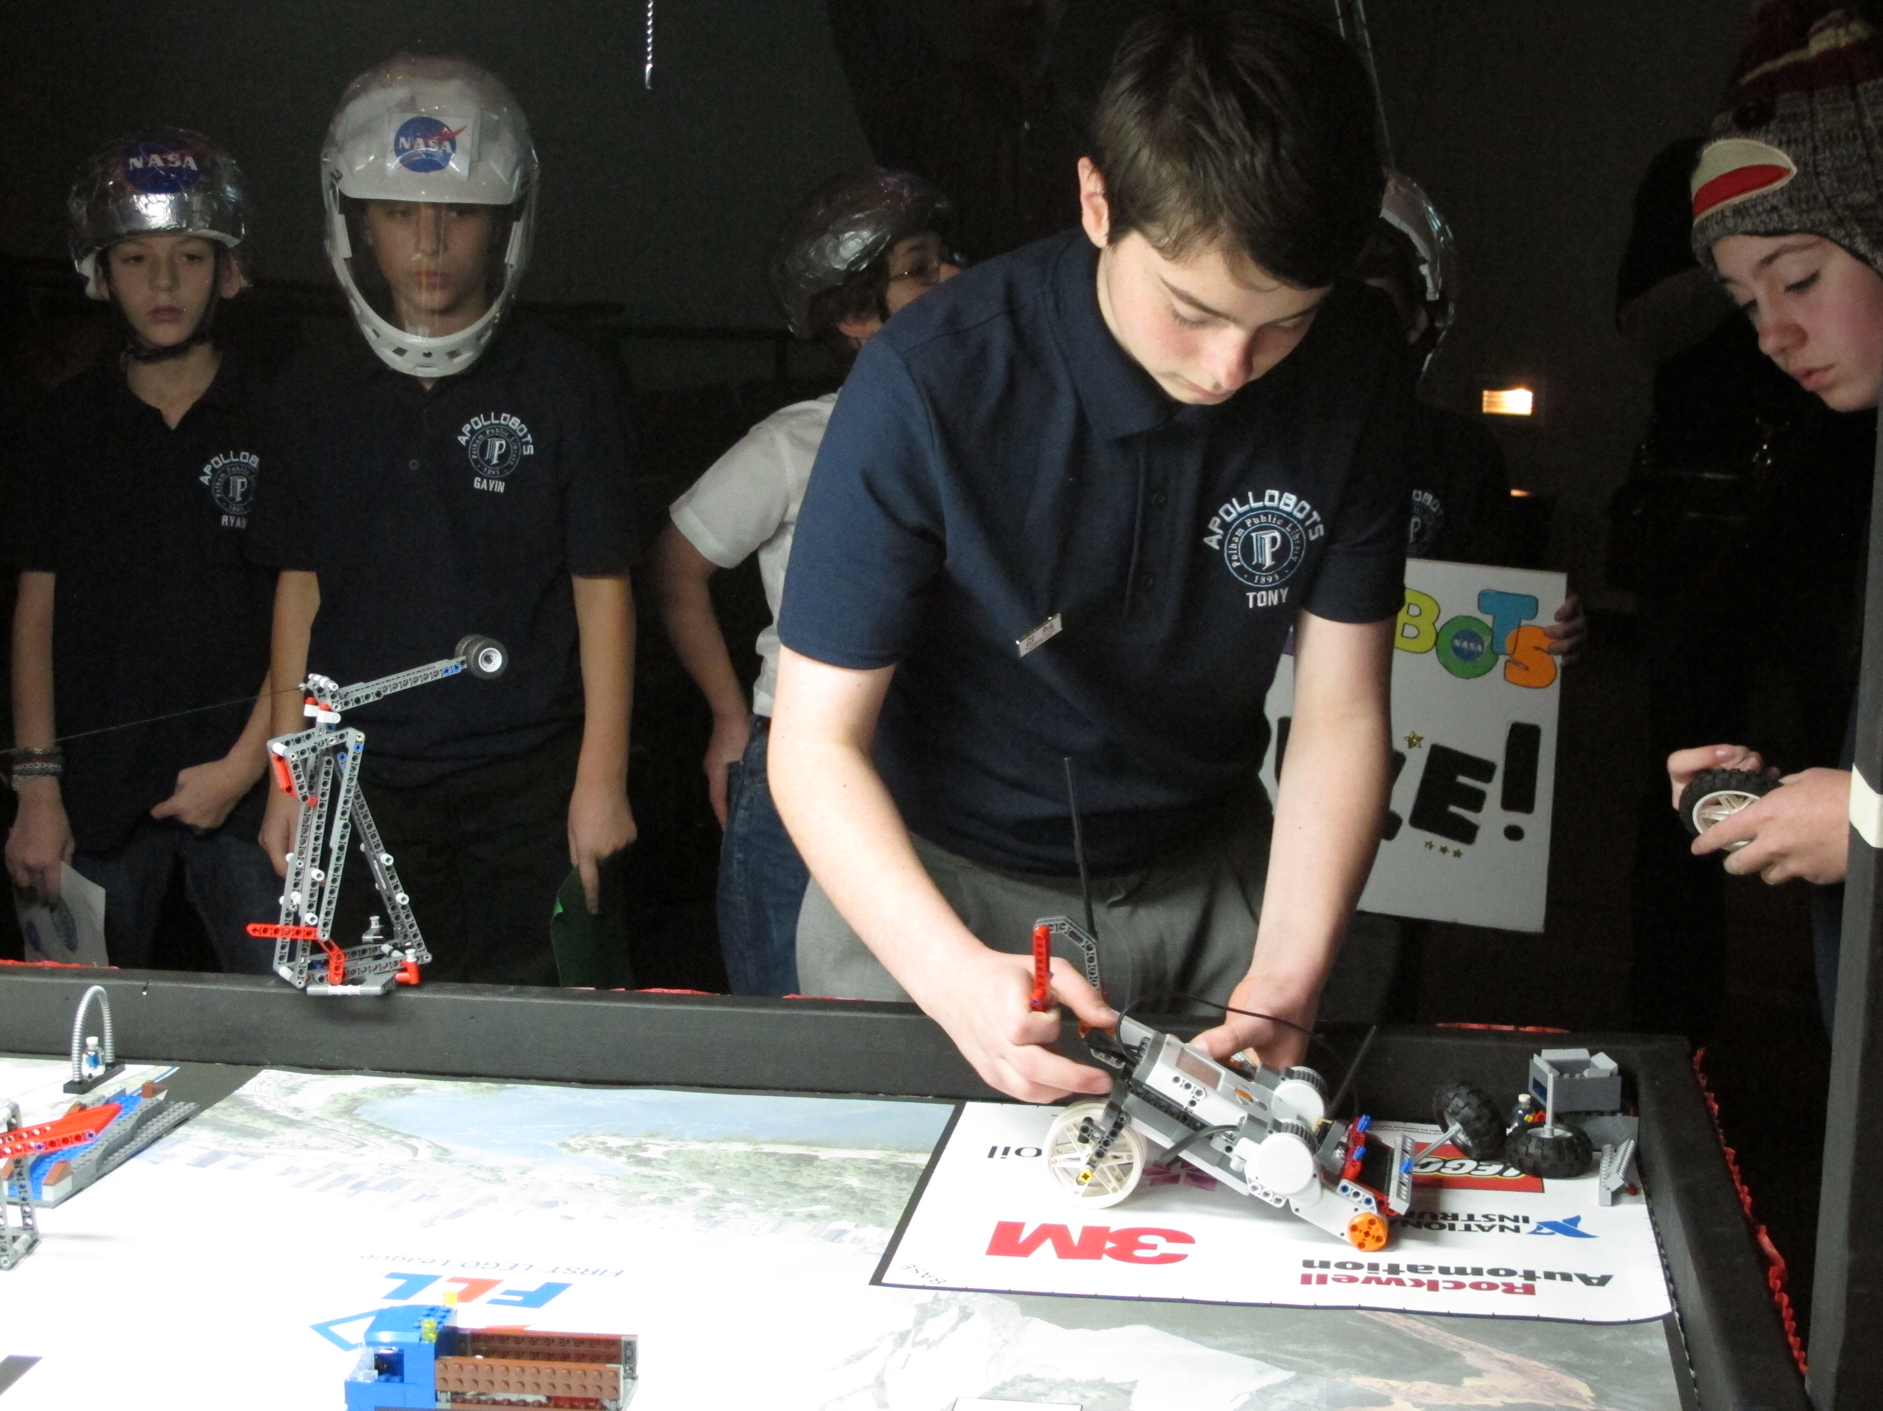
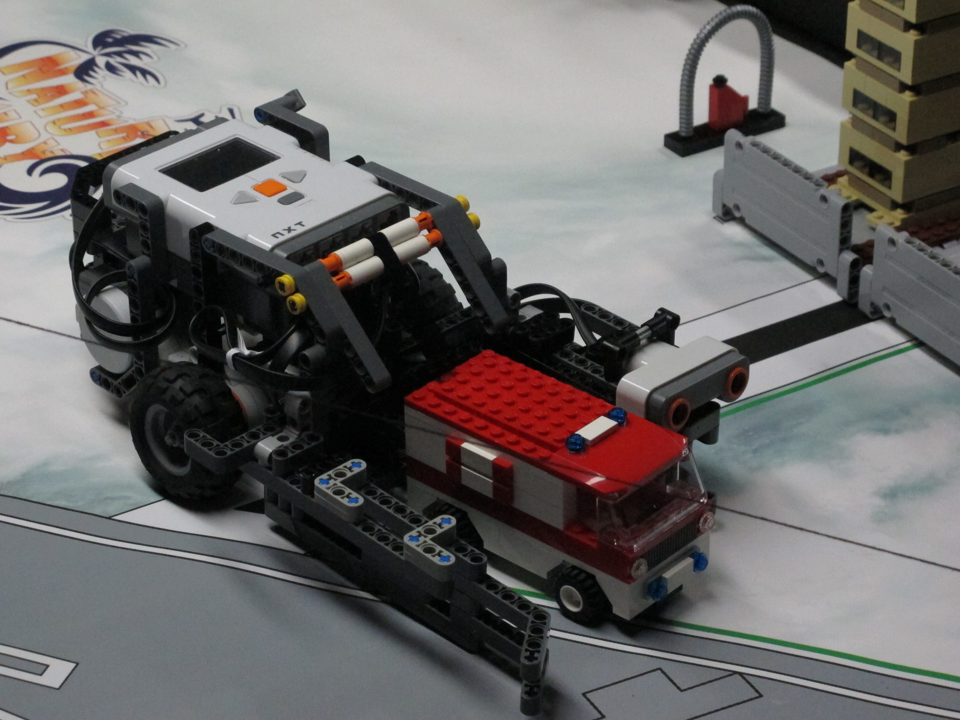
FIRST Lego League (FLL) Tournament

Slide 23
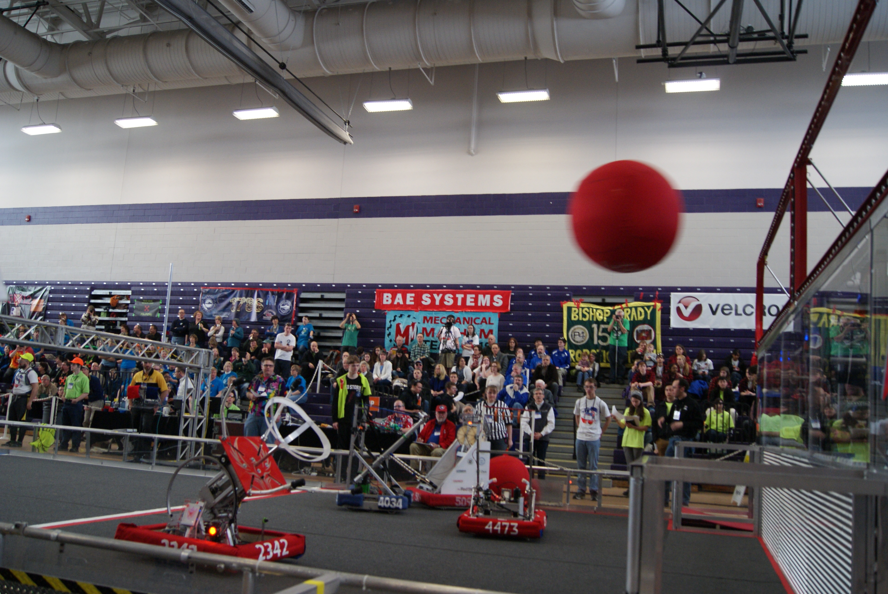
Build Season
This Year’s Game
Prototyping
Building the Robot

Slide 24

This Year’s Challenge – Aerial Assist

Slide 25
Prototyping
We wanted a robot that could do all aspects of the 2014 FRC design challenge; play defense, shoot, pick up ball, and receive the ball. We chose this robot’s design through several brainstorming sessions because it encompassed what we wanted in an all-in-one machine.

Slide 26
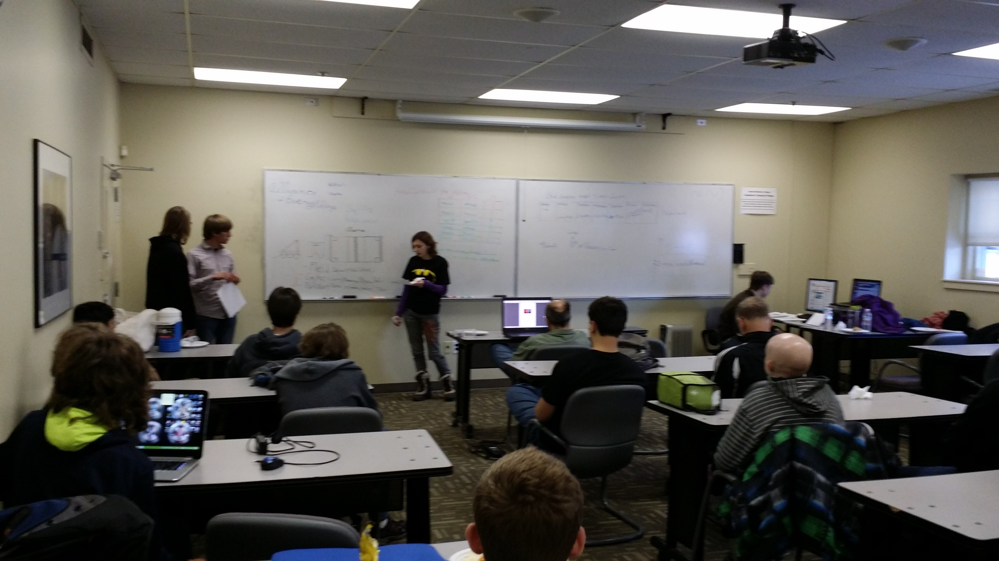
Photos – Prototyping

Slide 27
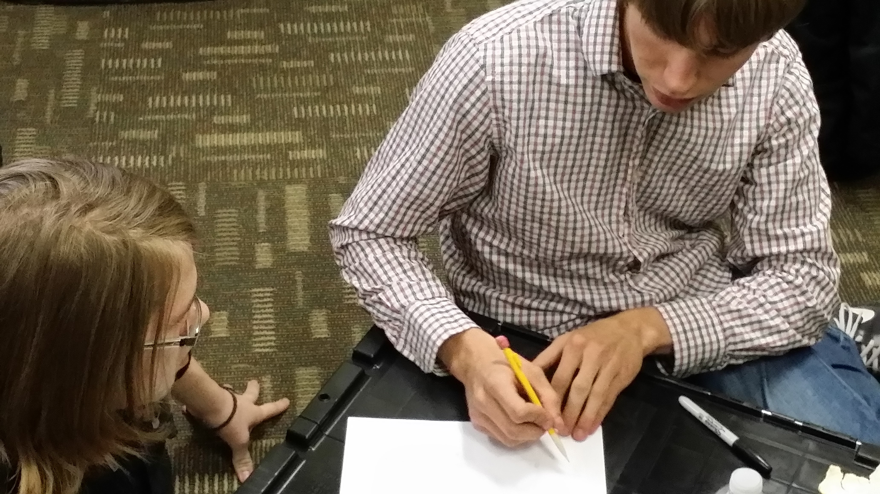
Photos – Prototyping

Slide 28
Building the Robot
Mechanical
CAD
Machining
Controls
Wiring
Programming

Slide 29
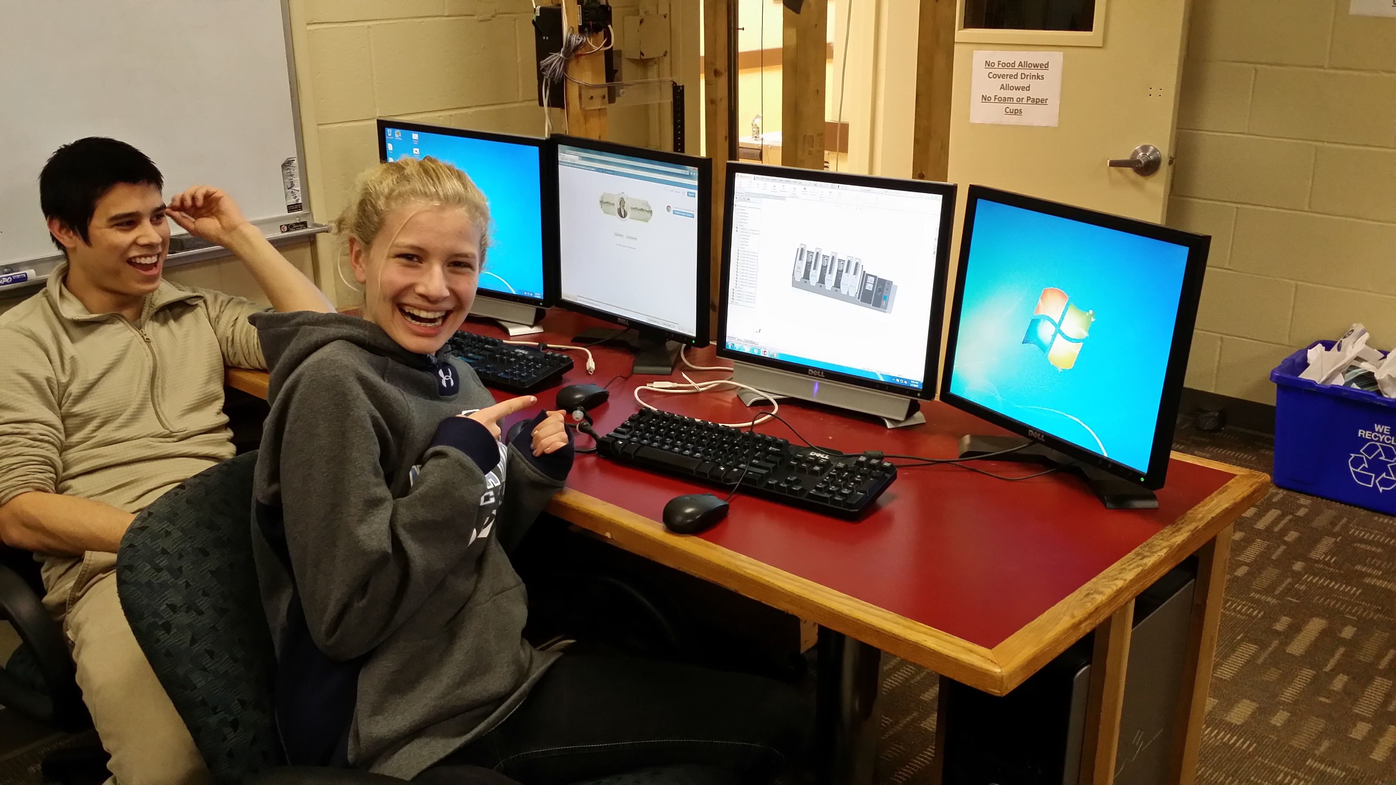
CAD – Mechanical

Slide 30
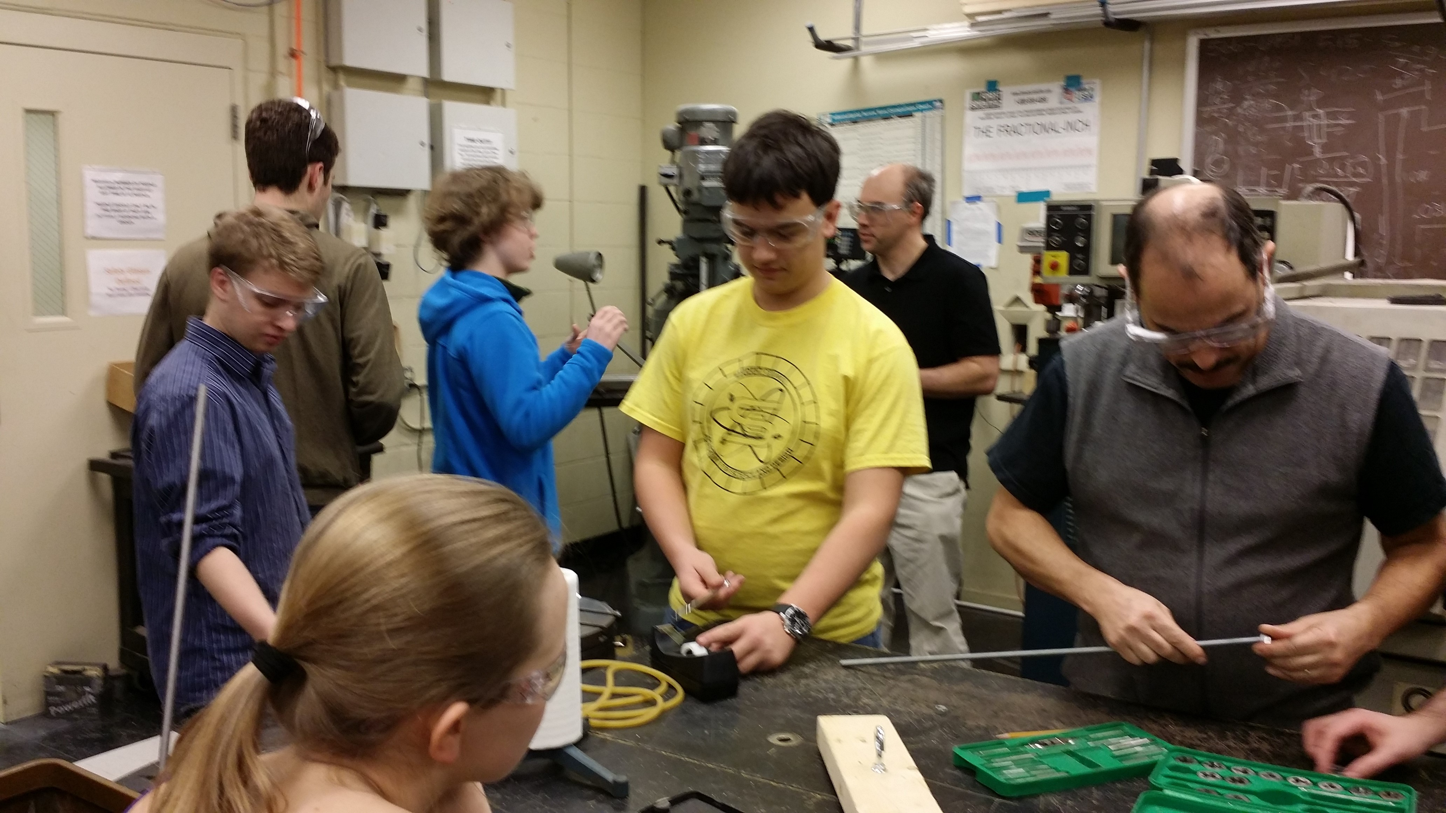
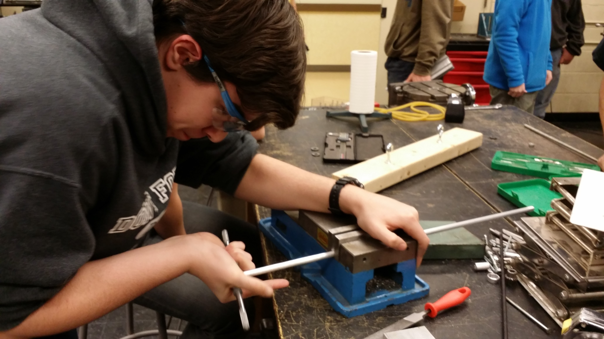
Machining – Mechanical

Slide 31
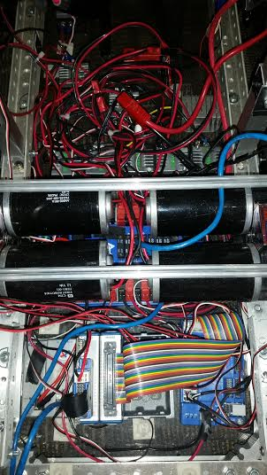
Wiring – Controls

Slide 32
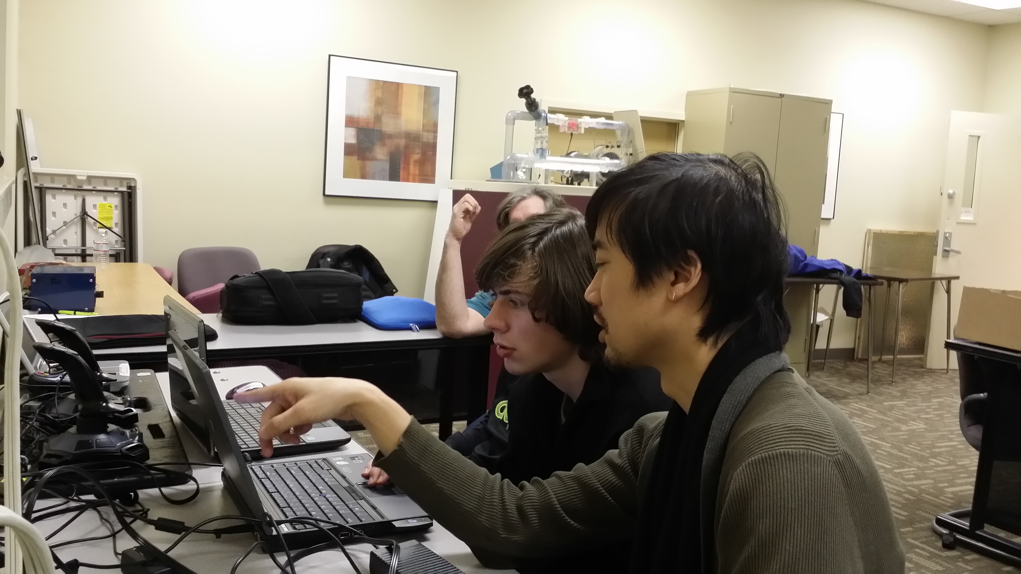
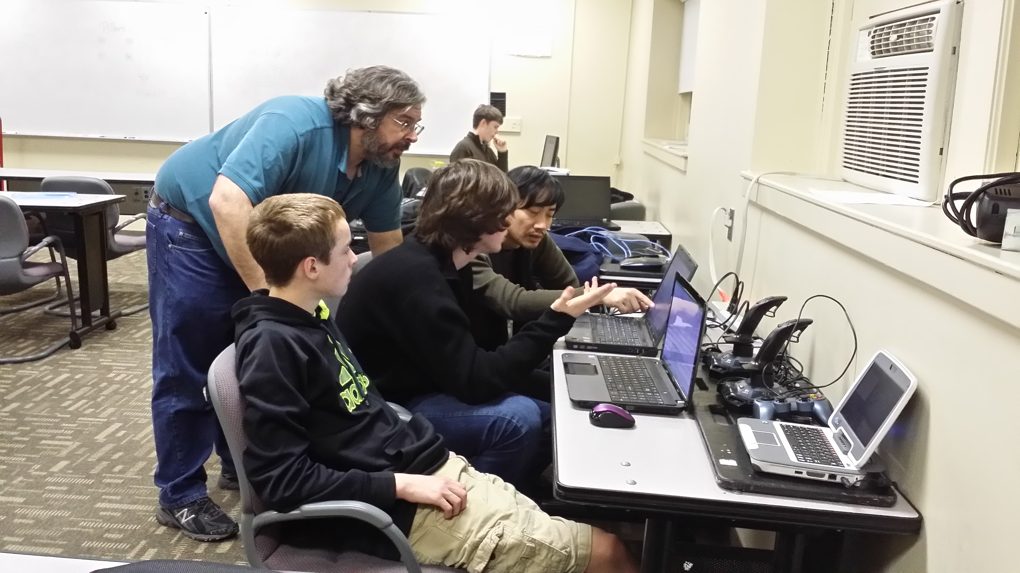
Programming – Controls

Slide 33
Granite State District Event
The Granite State District Event took place at Nashua South High School in Nashua, NH.
To the left is a photo of our robot scoring.

Slide 34
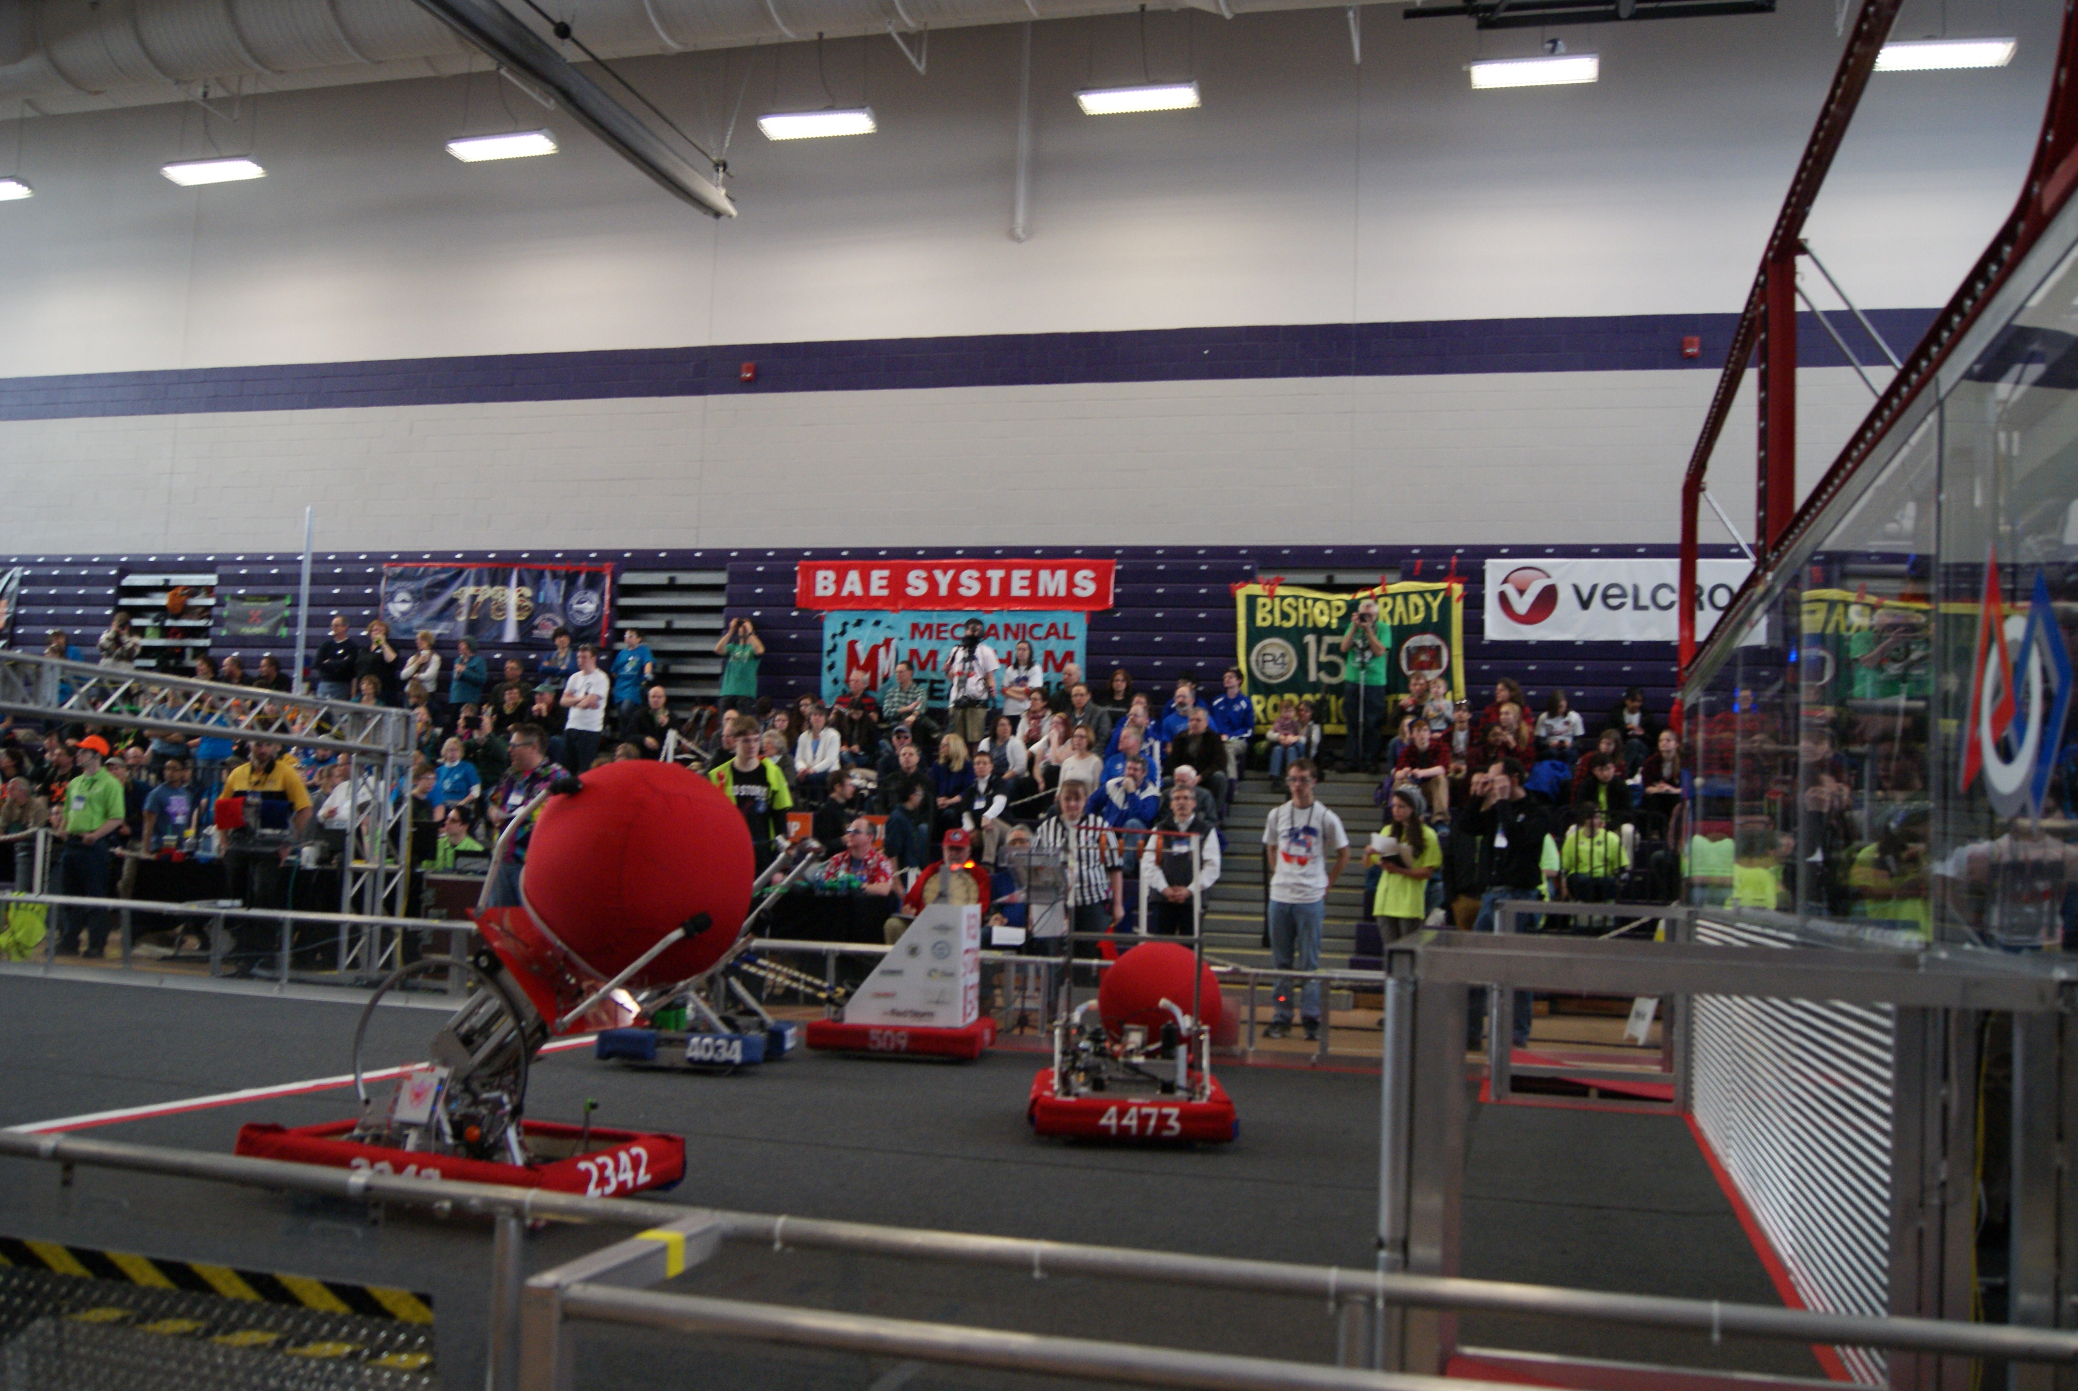
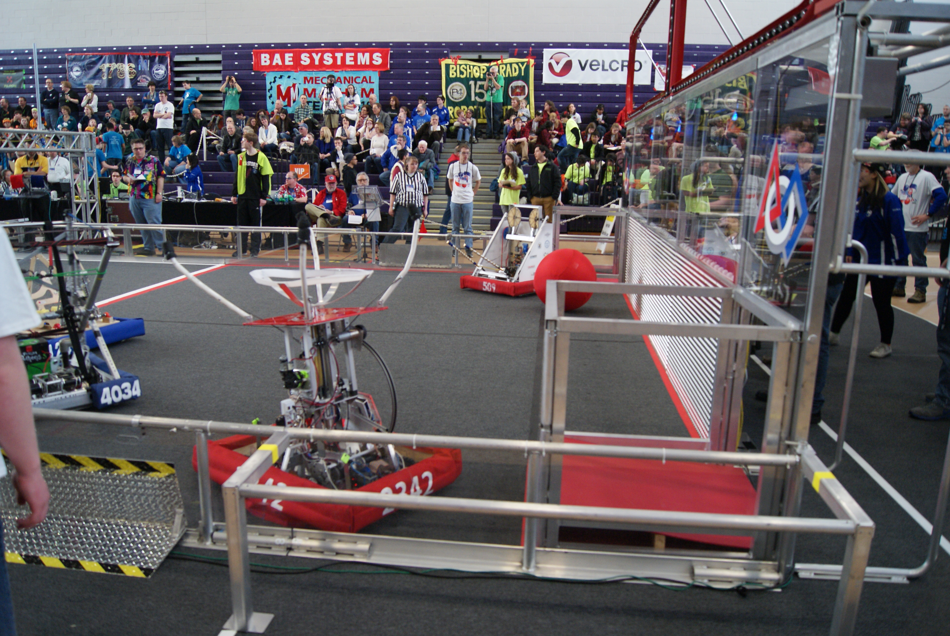
Playing – Granite State District Event

Slide 35
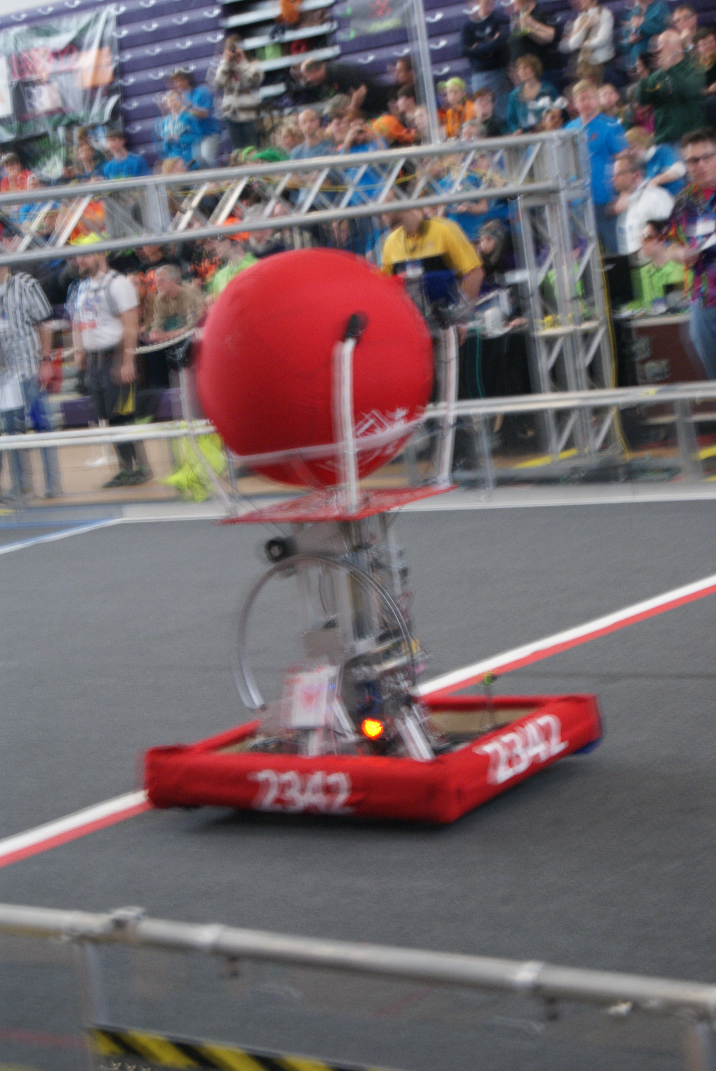
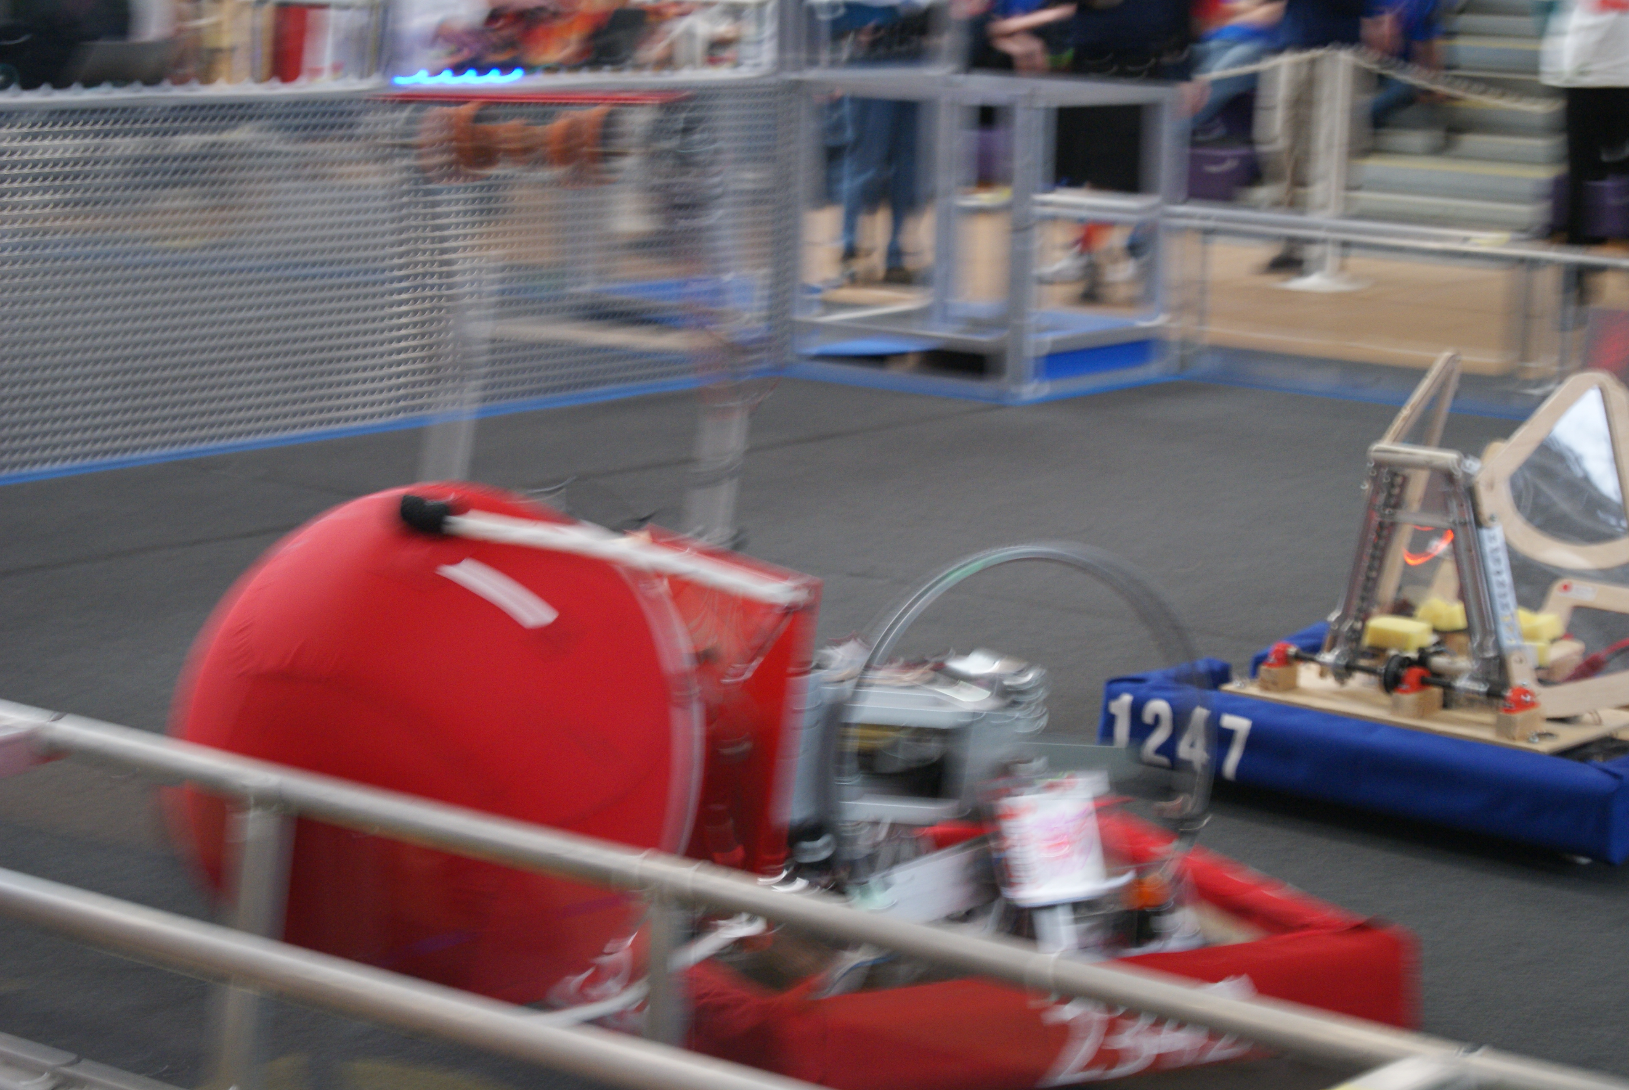
Playing – Granite State District Event

Slide 36
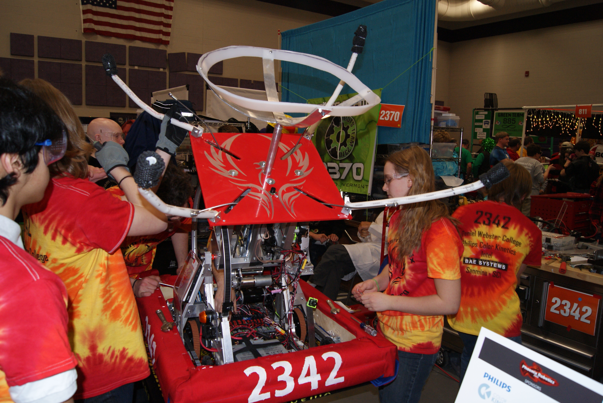
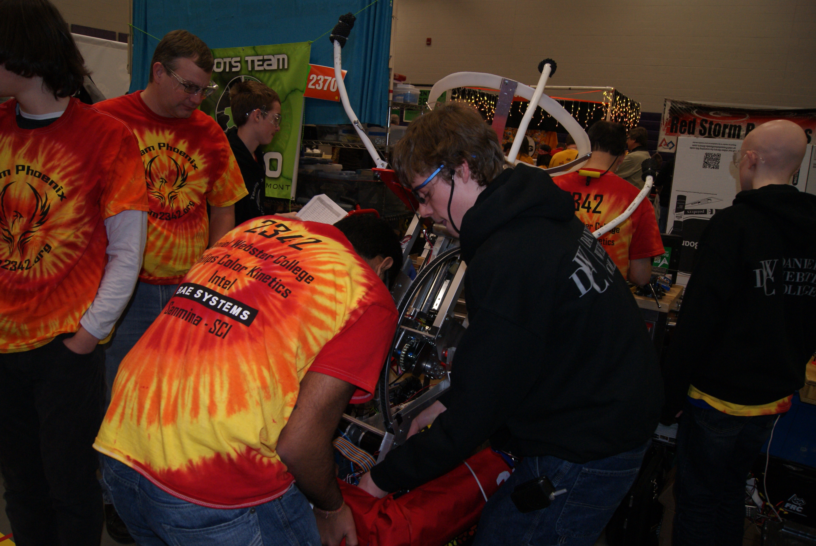
Pits – Granite State District Event

Slide 37
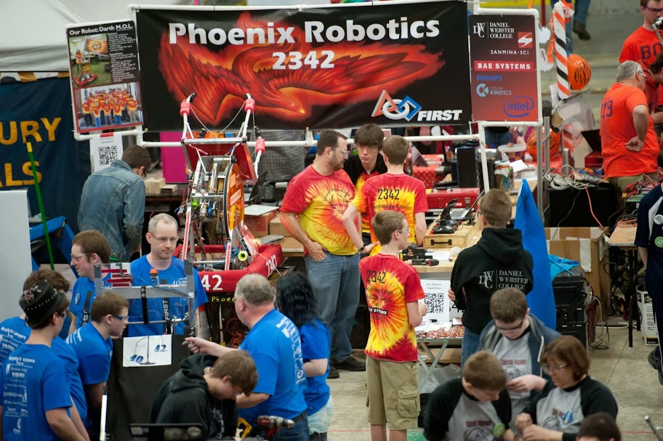
Pine Tree District Event
The Pine Tree District Event was our second competition. It took place in Lewiston, ME at the Androscoggin Bank Colisée.
To the left, a picture of our robot in our pit.

Slide 38
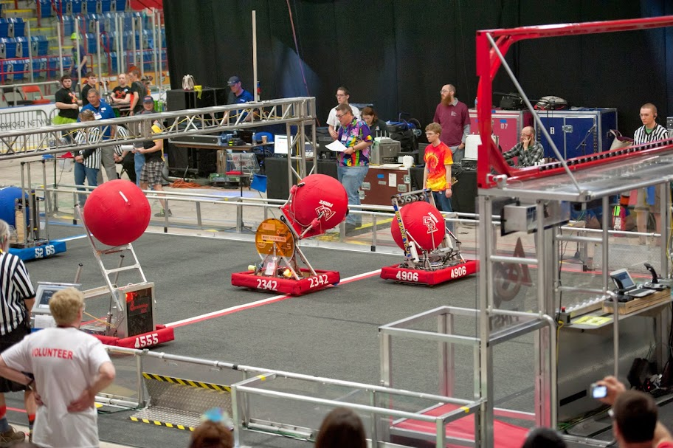
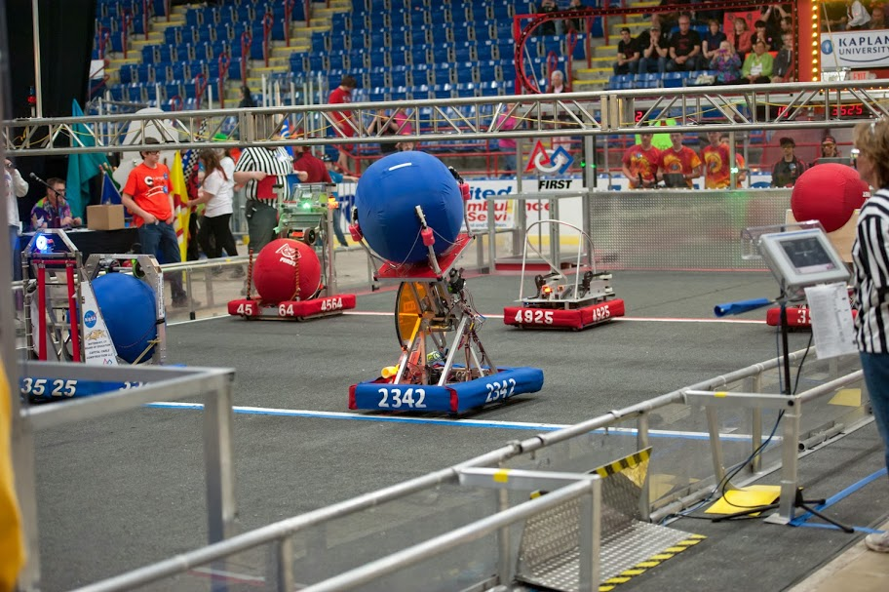
Playing – Pine Tree District Event

Slide 39
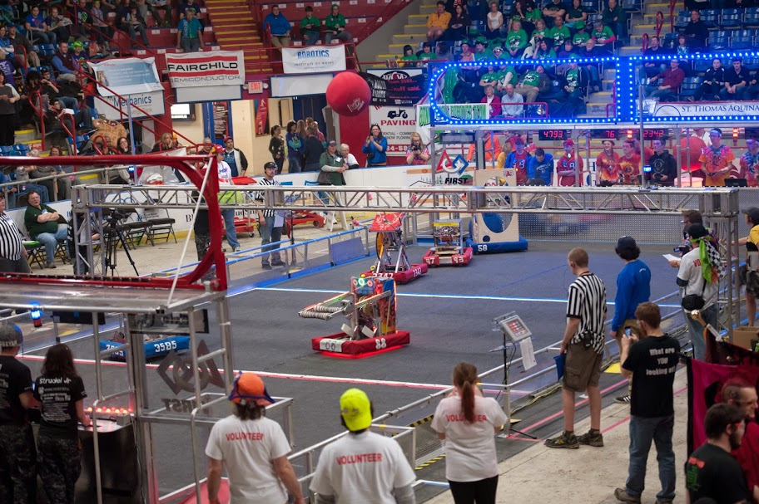
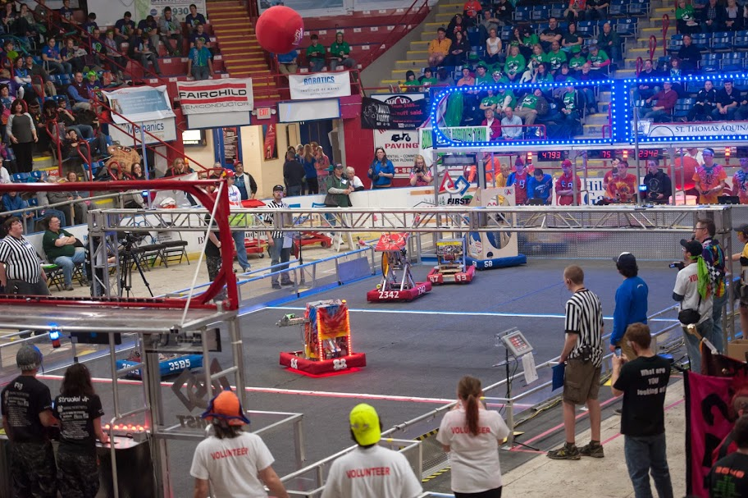
Playing – Pine Tree District Event

Slide 40
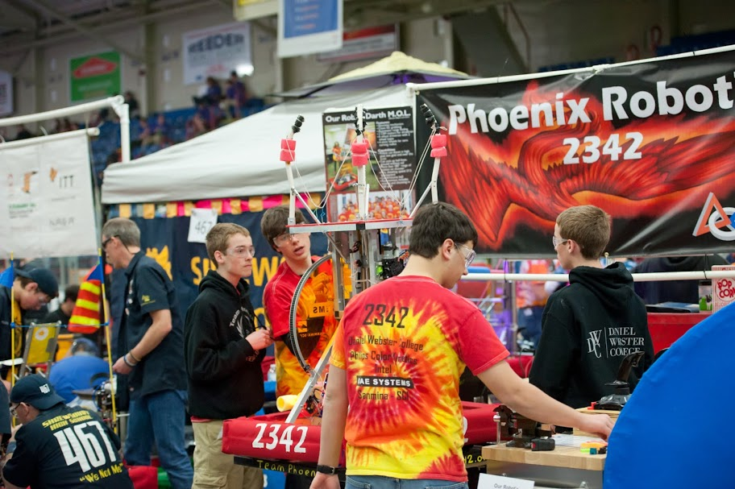
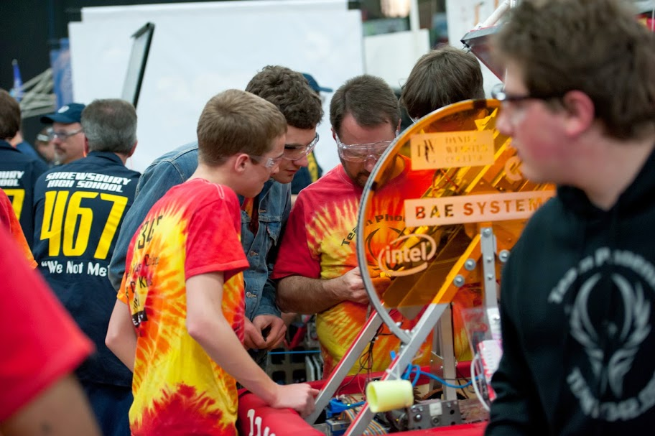
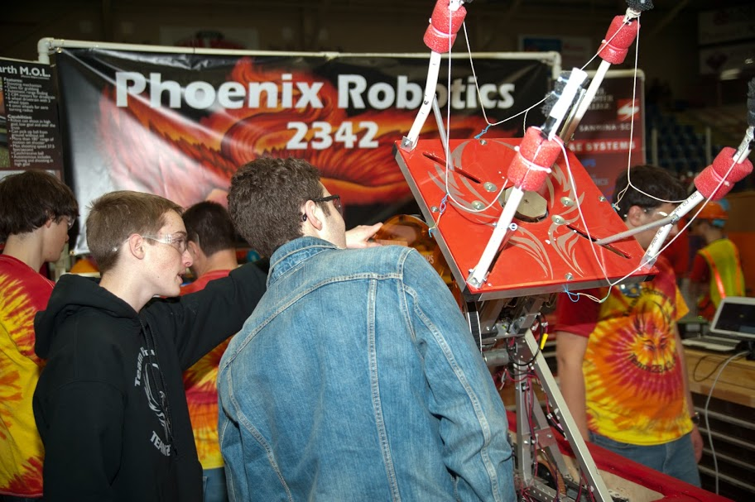
Pits – Pine Tree District Event

Slide 41
Judges Award
We won the 2014 Pine Tree District Event Judges Award for our amazing growth after our team had only 7 remaining key students at the end of the 2013 season (last year). The team today consists of 24 students. To quote our motto, we have truly risen from the ashes.

Slide 42
Lessons Learned
Systems—planning and management—is very important for the success of the season.

Slide 43
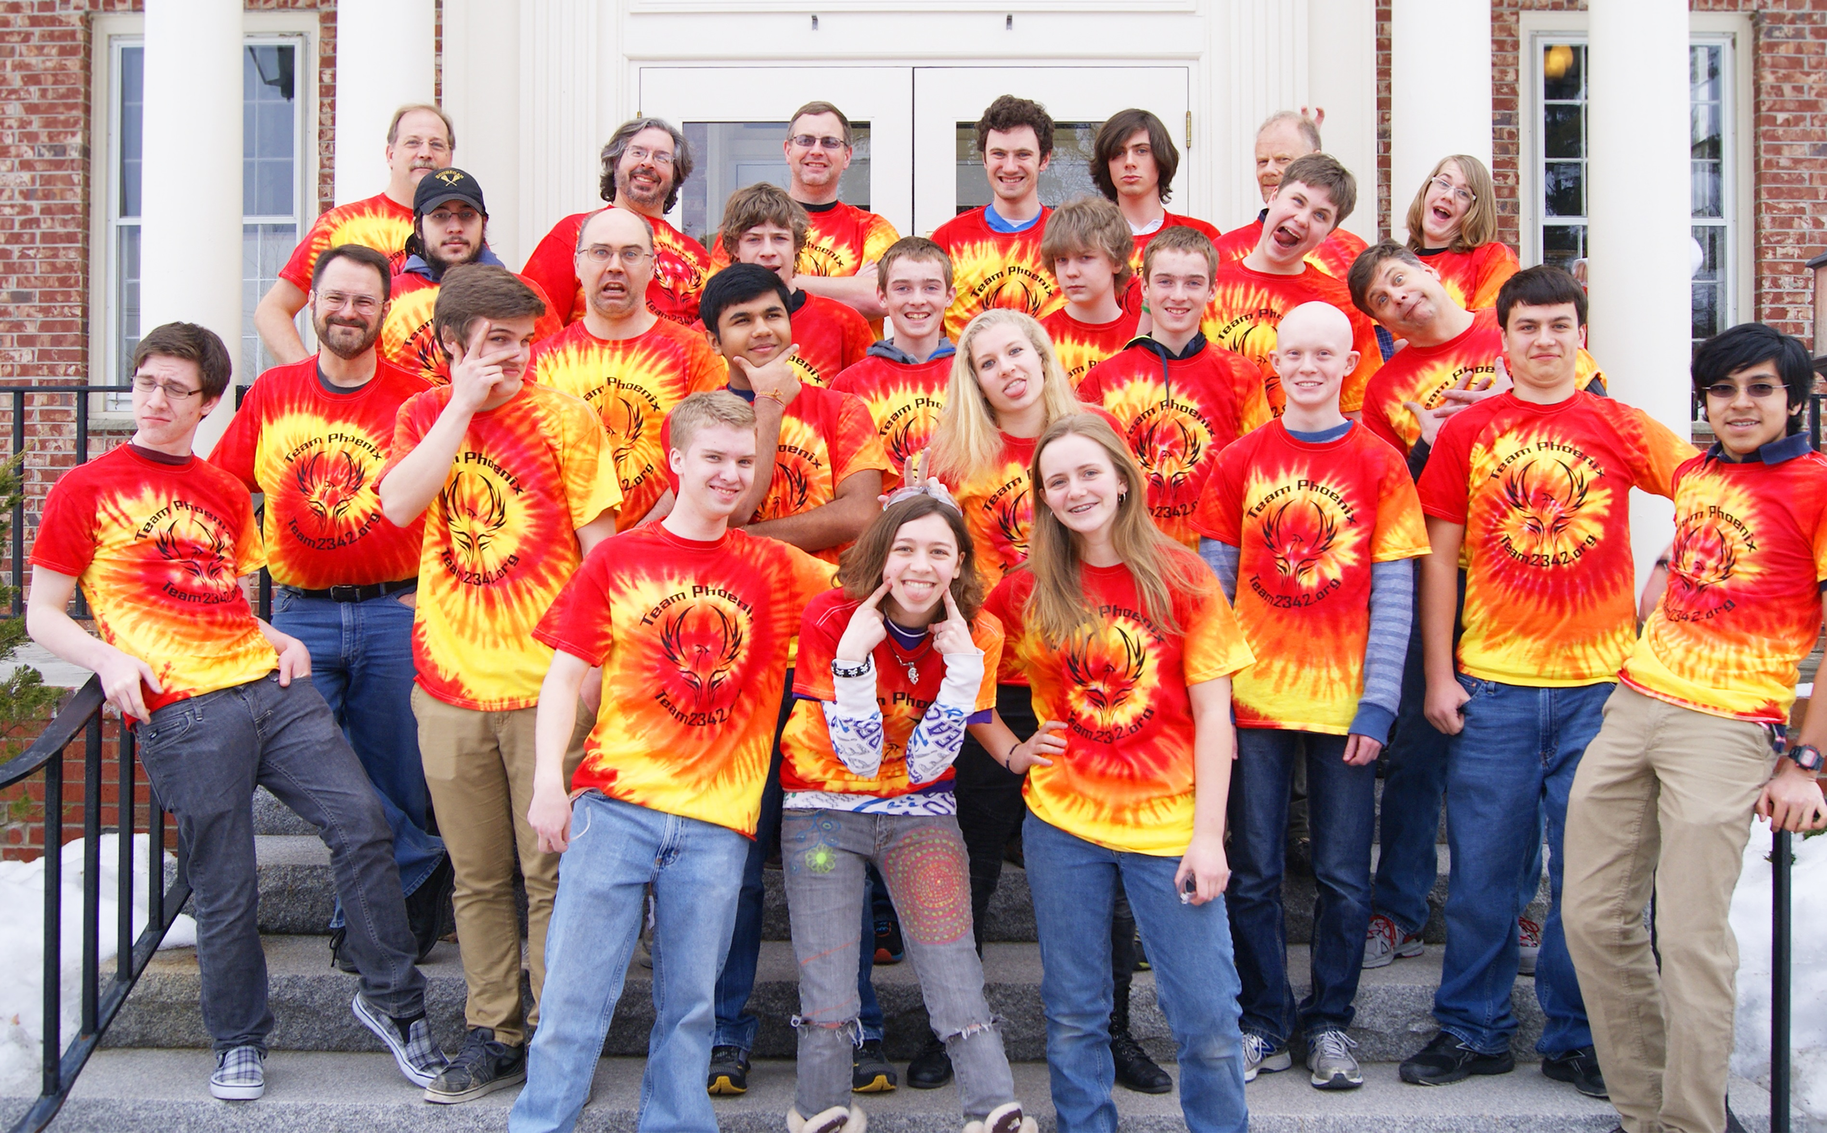
Thank you for supporting us! Your support is fundamental to our team
Check out our website at www.team2342.org
Subscribe to our newsletter at www.team2342.org/subscribe

